Slide 1

Lay Leadership Training

Slide 2
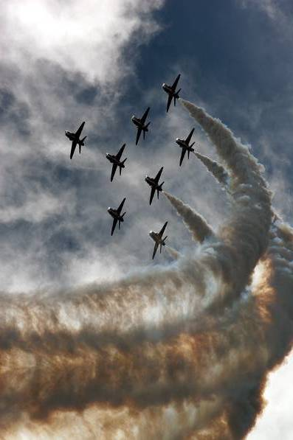
Leadership Styles
Leadership Skills
Leading meetings
Encouraging participation
Team and Group Dynamics
Managing Volunteers

Slide 3
Group agreement
Respect difference
Be a good listener
Challenge constructively
Give space so that all may contribute if they wish
Take responsibility for own learning
Questions are good
Mobile phones on silent please
Respect boundaries of confidentiality

Slide 4
What do you value most about your role?
What aspects of leadership can you identify?
What makes for good leadership in a church context?

Slide 5
Work Orientations -
How do we view our work – is it a Job, a Career, or a Calling?
People with a ‘job’ see work as a chore and their pay cheque is the reward.
People with a ‘career’ work not only out of necessity but also to advance and succeed. They are invested in their work and want to do well.
People with a ‘calling’ view work as an end in itself; they feel it contributes to the greater good, draws on their personal strengths, and gives them meaning and purpose.
Notes:
Cathedral In our Our Work

Slide 6
Leadership Styles
‘Leadership style is a function of personality rather than a strategic choice?’
Discuss!

Slide 7
Leadership Styles & Emotional Intelligence
Self-Awareness
Self-Management
Social Awareness
Social Skills

Slide 8
Leadership Styles
 | Commanding | Visionary | Affiliative | Democratic | Pacesetting | Coaching
The Leader’s Modus Operandi | Demands immediate compliance | Mobilizes people towards a vision | Creates harmony and builds emotional bonds | Forges consensus through participation | Sets high standards for performance | Develops people for the future
The style in a phrase | “Do what I tell you.” | “Come with me.” | “People come first.” | “What do you think?” | “Do as I do, now.” | “Try this.”
Underlying Emotional Intelligence competencies | Drive to achieve, initiative, self-control | Self-confidence, empathy, change catalyst | Empathy, building relationships, communication | Collaboration, team leadership, communication | Conscientiousness, drive to achieve, initiative | Developing others, empathy self-awareness
When the style works best | In a crisis, to kick start a turnaround, or with problem employees | When changes require a new vision, or when a clear direction is needed | To heal rifts in a team or to motivate people during stressful circumstances | To build buy-in or consensus, or to get input from valuable employees | To get quick results from a highly motivated and competent team | To help an employee improve performance or to develop long-term strengths
Overall impact on climate | Negative | Most strongly Positive | Positive | Positive | Negative | Positive

Slide 9
Six Styles of Leadership
Coercive/Commanding
Authoritative/Visionary
Affiliative
Democratic
Pacesetting
Coaching

Slide 10
Commanding
Demands immediate compliance
“Do what I tell you.”
Drive to achieve, initiative, self-control
In a crisis, to kick start a turnaround, or with difficult employees
Negative

Slide 11
Visionary
Mobilizes people towards a vision
“Come with me.”
Self-confidence, empathy, change catalyst
When changes require a new vision, or when a clear direction is needed
Most strongly positive

Slide 12
Affiliative
Creates harmony and builds emotional bonds
“People come first.”
Empathy, building relationships, communication
To heal rifts in a team or to motivate people during stressful circumstances
Positive

Slide 13
Democratic
Forges consensus through participation
“What do you think?”
Collaboration, team leadership, communication
To build buy-in or consensus, or to get input from valuable employees
Positive

Slide 14
Pacesetting
Sets high standards for performance
“Do as I do, now.”
Conscientiousness, drive to achieve, initiative
To get quick results from a highly motivated and competent team
Negative

Slide 15
Coaching
Develops people for the future
“Try this.”
Developing others, empathy, self-awareness
To help an employee improve performance or develop long-term strengths
Positive

Slide 16
Leadership Styles
 | Commanding | Visionary | Affiliative | Democratic | Pacesetting | Coaching
The Leader’s Modus Operandi | Demands immediate compliance | Mobilizes people towards a vision | Creates harmony and builds emotional bonds | Forges consensus through participation | Sets high standards for performance | Develops people for the future
The style in a phrase | “Do what I tell you.” | “Come with me.” | “People come first.” | “What do you think?” | “Do as I do, now.” | “Try this.”
Underlying Emotional Intelligence competencies | Drive to achieve, initiative, self-control | Self-confidence, empathy, change catalyst | Empathy, building relationships, communication | Collaboration, team leadership, communication | Conscientiousness, drive to achieve, initiative | Developing others, empathy self-awareness
When the style works best | In a crisis, to kick start a turnaround, or with problem employees | When changes require a new vision, or when a clear direction is needed | To heal rifts in a team or to motivate people during stressful circumstances | To build buy-in or consensus, or to get input from valuable employees | To get quick results from a highly motivated and competent team | To help an employee improve performance or to develop long-term strengths
Overall impact on climate | Negative | Most strongly Positive | Positive | Positive | Negative | Positive

Slide 17
The Myth of the Flawless Being! or
Three Cheers for the Incomplete Leader!

Slide 18
Leadership Capabilities Organizations Need
Sensemaking – interpreting developments
Relating – building trusting relationships
Visioning – communicating a compelling image of the future
Inventing – coming up with new ways of doing things

Slide 19
The Flawless Being
Has it all figured out
Is good at everything (all the capabilities)
Feigns confidence
Hides weaknesses
Exhausts themselves
Endangers their organization

Slide 20
The Incomplete Leader
Accepts they are human – with strengths and weaknesses
Understands the leadership capabilities needed by organizations
Finds and works with others who can provide the capabilities they are missing
Promotes leadership and unleashes potential

Slide 21
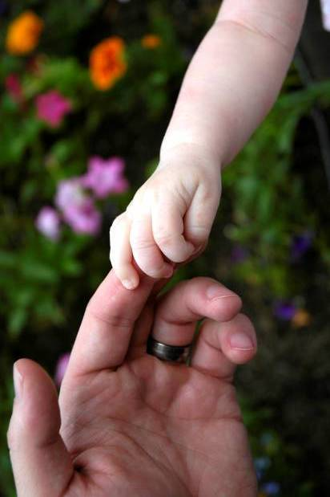
Leadership
What features are important?
prayerful
discerning
collaborative
relational
holy
courageous
risk-taking
obedient
resilient
humble
serving
flexible
creative
visionary
inspiring
accountable
teachable
apprenticing
missional
strategic
balanced
culturally authentic
leaders!
any other suggestions?
Notes:
Which of these best describe the way you lead?
Where is there room for development?

Slide 22
Coffee break

Slide 23
Team and Group Dynamics
A team is… a group of people committed to work to a common purpose which seeks to maximise the effectiveness of its members’ contributions, gifts and resources so that each is built up as harmonious and fruitful relationships develop.

Slide 24
Lencioni’s five dysfunctions of a team
Inattention to
Results
Avoindance of accountability
Lack of Commitment
Fear of Conflict
Absence of Trust

Slide 25
A Functional Team
Focussing on Goals
Being accountable
Commitment to the task
Expressing disagreement
Developing Trust
Notes:
Trusting one another is part and parcel of our calling to follow Christ. However, we don’t always find it easy. Trust within a group is about being willing to be open and vulnerable to one another, to believe that every team member has the other members’ best interests at heart and is equally committed to the task of the group. With that sort of trust among members, getting on with the job in hand is easier because the normal blockages have been removed.
So developing trust within the group is a foundation stone to functional and effective team working.

Slide 26
To Trust or Not to Trust
Ask each member share their response with the rest of the team to the following two areas – take each theme separately (leader goes first!) Make sure you leave enough time for everyone to speak:
1. Talk about your name – how you came by it, how you feel about it
2. Share your most memorable spiritual experience
Notes:
This first exercise offers a simple way into discovering a little more about the team members and possibly finding some ‘shared history’.

Slide 27
Think of a group that you have been a member of where you felt there was trust among the members.
Why do you think you trusted one another?
How did it feel being part of that group?
1. What causes us to trust?
Now think of a group where you felt there wasn’t trust.
Why do you think that was?
How did it feel being part of that group?
2. What causes us not to trust?
Notes:
Collect the post it notes onto two sheets of flip chart paper, one headed ‘What causes us to trust?’ and the other headed ‘What causes us not to trust?’
Spend a few minutes reading what everyone has written and then brainstorm onto a flip chart words which you think would engender trust in the team.
Finally spend a couple of minutes reflecting in silence on the question: ‘How do I help to create that trusting relationship in the team?’

Slide 28
Why Team?
Some reasons for team
models Christian community life, learning and mentoring for future leaders
shares authority and responsibility and offers a place for mutual accountability
gathers the human resources, the team can achieve more than individuals
areas of weakness are covered by the strengths of others
enables support and diminishes the possibility of burnout and disillusionment
Notes:
28

Slide 29
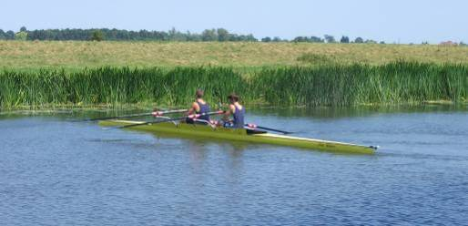
Team differences – the key
working or working
for against

Slide 30

The range of differences
What are the main ways in which team members can be different?
Notes:
Theology spectrum

Slide 31
Being accountable to each other
Two are better than one, because they have a good return for their labour: If either of them falls down, one can help the other up. But pity anyone who falls and has no one to help them up. Also, if two lie down together, they will keep warm. But how can one keep warm alone? Though one may be overpowered, two can defend themselves. A cord of three strands is not quickly broken. (Ecclesiastes 4:9-12)

Slide 32
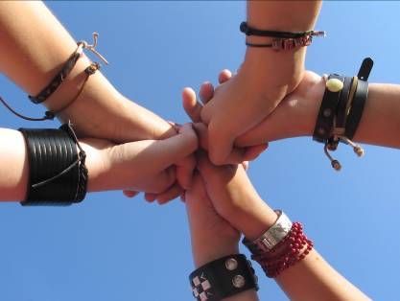
A rounded team
What motivates you?
task, people or principles
Belbin team roles
15 years of research
eight roles make a rounded team
Notes:
Belbin Handout from CLT training

Slide 33
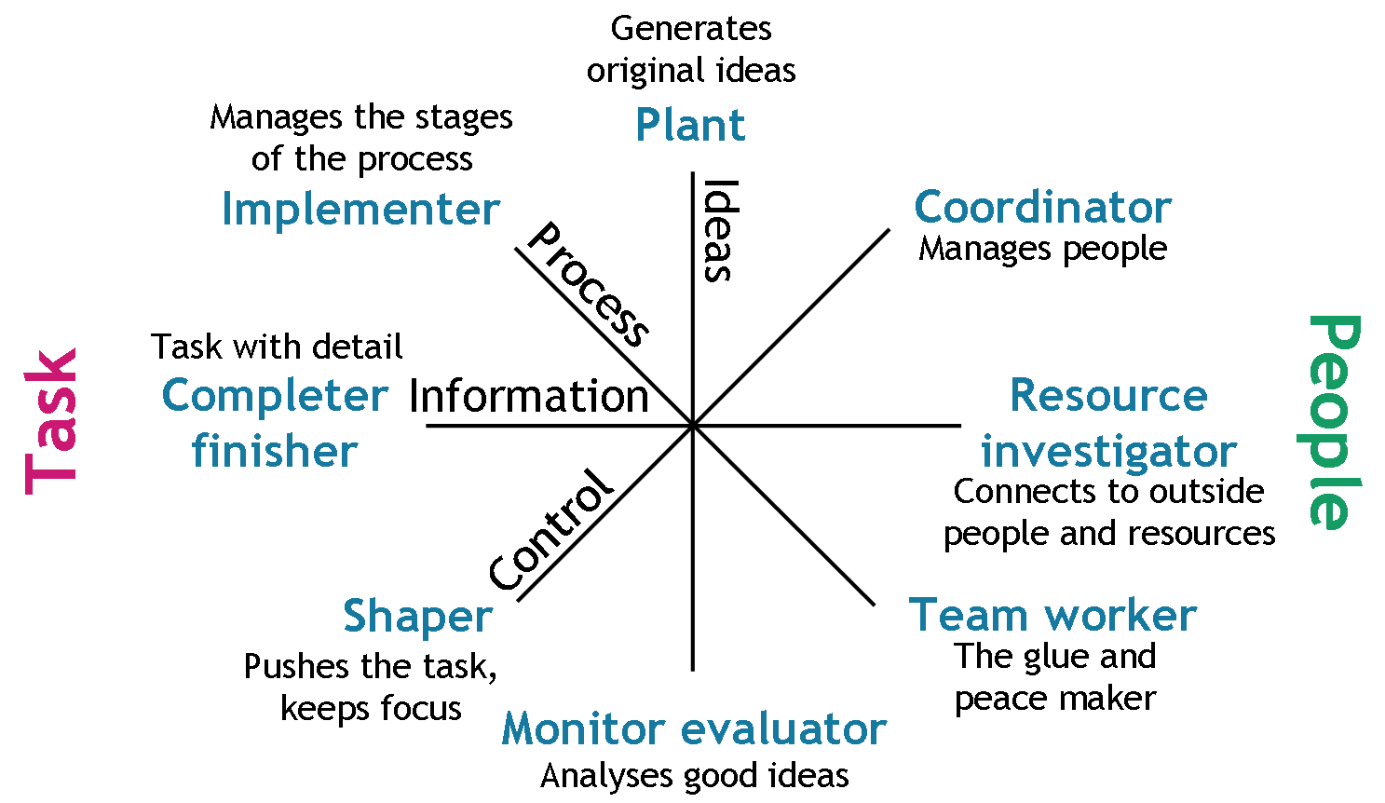
Belbin Team Roles

Slide 34
Lunch

Slide 35
Disagreement
There is a tendency in church meetings to be ‘nice’ no matter how we actually feel about what is being said.
Often the prevailing conviction is that we should avoid disagreement and definitely not encourage any sort of conflict among members.
Lencioni maintains that it is only by ‘mining for conflict’ i.e. openly encouraging it and engaging with it, that we can truly be honest with one another and thus ‘own’ any decisions made, even if they are not the ones we would naturally have chosen.
Notes:
We think the Christian way is to seek to agree with one another even if it means we go and shout at the cat when the meeting is over. Or, worse, express annoyance and disagreement to other members of the church outside the meeting about decisions that we apparently supported.
The following exercise offers you some ways of thinking about conflict and disagreement.

Slide 36
Holding one another to account for performance or behaviours that hurt the team is one of the most difficult aspects of the Lencioni model. As he says: ‘The essence of this dysfunction is the unwillingness of team members to tolerate the interpersonal discomfort that accompanies challenging a peer on his or her behaviour and the more general tendency to avoid difficult conversations.’
(p213, The Five Dysfunctions of a Team).

Slide 37
We’re going to use a tool called the Human Rainbow (also sometimes known as the ‘conflict spectrum’)
Notes:
The notes that follow give some points along the rainbow, but it’s important that each person imagines the whole spectrum of responses and makes their own decision about where to stand.
At one end of the rainbow: You believe that open disagreement and even heated discussion help to reveal where people disagree and that this helps you make good decisions
At the other end: You believe it is wrong to hurt people’s feelings by disagreeing with them even if that means you don’t say what you really think.
Around the centre: You believe decisions are best made after discussion – so long as we don't upset anyone
Human Rainbow’ is a good term to use because:
• The rainbow has a variety of colours
• The colours fade into each other – and our views are not always clear-cut
So the rainbow helps us see a variety of opinions.
This is how it works:
• There’s no right or wrong place to stand – it’s up to you
• It’s important to decide where you’re going to stand before the signal to move – so that you are not swayed by the group
• Different people may decide to place themselves at similar places on the rainbow for different reasons
When all have had time to decide, move to your chosen positions without consulting each other.
When all are in position:
• Share with the whole group what you observe about the group
• Chat with one or two people near to you about why you chose that position;

Slide 38
Conflict Styles
What is conflict?
What is my preferred style when responding to conflict?
What are the benefits and costs of each style?

Slide 39
Conflict
Role-play

Slide 40
Managing Meetings
De Bono’s Six Thinking Hats
Edward de Bono offered a way of approaching difficult subjects. Using his ‘Six Thinking Hats’, team members can step out of their usual thinking style and assess a situation more objectively.
Look at the ‘Thinking Hats’ and ask yourself which ‘Hat’ you tend to wear most often. And whether there are ones you’d never wear.
Notes:
We all use different types of thinking, usually without realising it. For example, we may react emotionally or objectively, or just be critical of every suggestion that’s made. Most of us have one or two thinking styles we tend to use most of the time without even thinking about it! Without our realising it, a discussion in a church council can be affected by the approach each member brings with them. So – difficult subjects don’t get tackled properly and are not resolved.
De Bono points out that no thinking style (or ‘Hat’) is any better or worse than any other, but a balanced team needs all ‘Hats’ so that together the members can consider all the aspects of whatever issues they are facing. This encourages collaborative working.
In de Bono’s method members of the team step out of their usual thinking styles and all wear the same colour ‘Hat’ at the same time, firmly directed by the person leading on that occasion. This helps the team as a whole to be more objective.
Look at the six hats, which of the hats do you most naturally tend to wear at a meeting? Try to be as honest as you can be. You may, of course wear more than one hat. Then share your thinking in small groups.

Slide 41
De Bono’s six thinking hats

Slide 42
Step 1: Present the facts of the case (white hat)
Step 2: Encourage people to share their gut feelings about the project (red hat)
Step 3: Generate ideas on how the situation could be handled (green hat).
Step 4: Evaluate the merits of the ideas:
List the benefits (yellow hat)  List the drawbacks (black hat)
Step 5: Get everybody’s gut feelings about the alternatives (back to the red hat).
Step 6: Summarise, agree a decision, next steps and an action plan and adjourn the meeting (blue hat).
Notes:
The Six Thinking Hats method could be used in a sequence first of all to explore the problem, and then develop a set of solutions, and finally agree on an approach.
At a future Meeting when you are faced with a difficult issue to discuss, try using the process as described and see if it helps you to come to any decisions. It’s important that the group facilitator is clear and firm about which hat you are all wearing at which stage, and that every member sticks to that hat until told to change. You may well want to use large sheets of flipchart paper to note your reactions at each stage.

Slide 43
Focussing on Goals
Handling meetings well
TIM
Tuckman
Notes:
Use hand-out on handling meetings from CLT Vision day

Slide 44
Vision -Mind the gap
What the world is
called to be
vision | call
What the world is
like now
Notes:
44

Slide 45
Values before Structures
Cell Church has coined the dictum:
Never change a structure until you have changed the values! ...Otherwise the cost is always too high.
The best process follows:
Values  Vision  Structures

Slide 46
1. Values - definitions
Values are those things ‘held in high esteem, prized, of worth or importance.’
  Values express our deepest convictions and passions, how we want to be known, how we expect to behave.”
Stuart Murray Williams

Slide 47
Comfort break

Slide 48
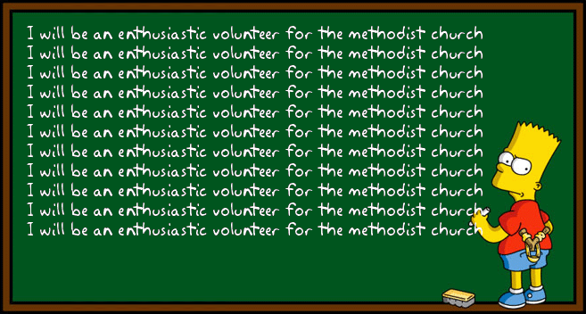
Managing volunteers

Slide 49
What are the key issues facing you in your work with volunteers?
Discuss in breakout rooms.

Slide 50
Pygmalion Effect
What we expect from people (and from ourselves) manifests itself in the words we use, and those words can have a powerful effect on end results.
This phenomenon is called the Pygmalion Effect: when our belief in another person’s potential brings that potential to life.
The expectations we have about our co-workers and volunteers—whether or not they are ever voiced—can make that expectation a reality.
People act as we expect them to act, which means that a leader’s expectations about what will motivate their employees often ends up coming true.

Slide 51
How can we keep volunteers motivated?
Discuss

Slide 52
Feeling valued
-actively listen
-include in appropriate decisions
-learn from them
-appreciate them

Slide 53
Don’t overwhelm volunteers
  Role description
  Expectations
  Confidence
  Support

Slide 54
Training/coaching
  Induction
  Training ‘on the job’
  Appropriate external training
  Give feedback

Slide 55
Seven steps
Joining | Welcome, introduction, initiation, commission, commitment
Holding | Show round, written vision, go over rewards/rules, make them feel a part of things
Supporting | Explaining, orientation, training, spend time together, equipping/resourcing, training
Growing | Challenge, assign roles, responsibility, delegating
Building | Team working, recognising, valuing and using gifts
Loving | Care, showing concern, accepting
Working | Fruitfulness together
Notes:
55

Slide 56
Enjoy what you do!
- share positive stories
- praise
- laugh

Slide 57
What has ben helpful?
What will you take away?

