Slide 1
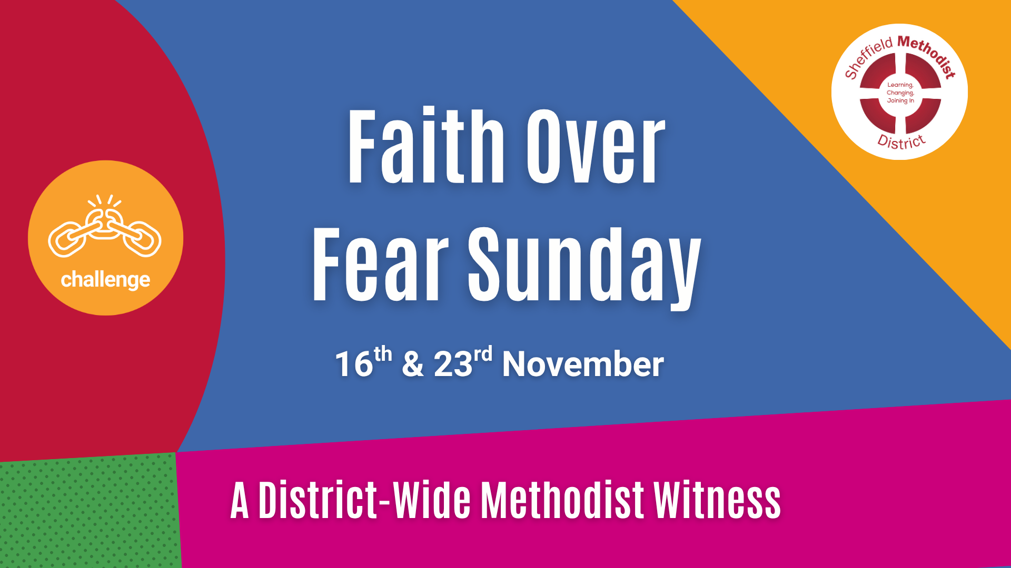

Slide 2
Faith over Fear Sunday
Resources

Slide 3
Call to Worship 1

Slide 4
Psalm 27:1, 3, 13–14
Leader: The Lord is my light and my salvation, whom shall I fear?
People: The Lord is the stronghold of my life, of whom shall I be afraid?

Slide 5
Leader: Though fears surround us and troubles press in, we will not lose heart.
People: We remain confident of this: we will see the goodness of the Lord in the land of the living!
All: We will wait for the Lord; we will be strong and take heart, and put our trust in God.

Slide 6
Call to Worship 2

Slide 7
Psalm 46:1–3, 10–11
Leader: God is our refuge and strength, a very present help in trouble.
People: Therefore we will not fear, though the earth should change and the mountains fall into the sea.

Slide 8
Leader: Nations are in uproar, kingdoms fall, but God’s voice stills the storm.
People: “Be still, and know that I am God!”
All: The Lord of hosts is with us; the God of Jacob is our refuge

Slide 9
Call to Worship 3

Slide 10
Psalm 56: 3–4, 10–11
Leader: When I am afraid, I put my trust in You.
People: In God, whose word we praise, in God we trust and are not afraid.

Slide 11
Leader: What can mere mortals do to us, when God is for us?
People: We will walk in the light of faith, not in the shadow of fear.
All: Our hope is in God, whose love endures forever.

Slide 12
Call to Worship 4

Slide 13
Psalm 91:1–2, 4–5
Leader: Those who dwell in the shelter of the Most High will rest in the shadow of the Almighty.
People: We will say of the Lord, “God is our refuge and fortress, in whom we trust.”

Slide 14
Call to Worship 4 – Psalm 91:1–2, 4–5
Leader: God will cover us with divine wings; under them we will find refuge.
People: We will not fear the terror of the night, nor the danger that stalks by day.
All: The Lord is our dwelling place; we will rest secure in God’s love.

Slide 15
Responsive Prayers of Praise and Thanksgiving
Option 1

Slide 16
Leader: God of love and light, we come before you in praise and thanksgiving.
You are the One who calms our fears and calls us by name. You breathe courage into our hearts and hope into our weary world.

Slide 17
When fear closes doors, your love opens them wide.
When voices of division rise, your Spirit whispers peace.
When we feel small or uncertain, you remind us that your grace is enough.

Slide 18
All: We thank you, God of perfect love, that nothing can separate us from you.

Slide 19
Leader: For the beauty of creation, for the kindness of friends and strangers, for the quiet strength that carries us through hard days we give you thanks.

Slide 20
All: Praise be to God, whose love drives out fear and whose mercy endures forever. Amen.

Slide 21
Responsive Prayers of Praise and Thanksgiving
Option 2

Slide 22
Leader: Faithful God, we praise you for the life you give, for your mercy that renews us morning by morning.

Slide 23
You do not ask for empty words or hollow worship, but for hearts alive with compassion and hands ready to serve.

Slide 24
You show us what love looks like feeding the hungry, welcoming the stranger, bringing justice where there is oppression.

Slide 25
All: We thank you, God of justice and grace, for calling us to be your people of courage and compassion.

Slide 26
Leader: For your Church, where love is shared and hope rekindled, for your Spirit at work in hidden places, for moments of forgiveness and new beginning we give you thanks.

Slide 27
All: To you be glory and praise, now and forever. Amen.

Slide 28
Prayer of Confession
Prayer 1

Slide 29
Leader: God of love and truth, we come before you in the quiet of this moment, aware of the ways we have let fear shape our living.
(silence)

Slide 30
When we have stayed silent when your Spirit called us to speak, when we have chosen comfort instead of courage, and safety instead of solidarity forgive us, O God.
(silence)

Slide 31
When we have turned away from our neighbours in need, or passed by those whose stories unsettled us, forgive us, O God.
(silence)

Slide 32
When we have doubted your love for us or failed to see your image in others, forgive us, O God, and restore in us the joy of faith, the strength of hope, and the depth of love that casts out fear.
(silence)

Slide 33
Absolution
Leader: Hear the good news: God’s perfect love drives out fear. In Christ we are forgiven, renewed, and made whole.
All: Thanks be to God. Amen.

Slide 34
Prayer of Confession
Prayer 2

Slide 35
Leader: God of mercy and justice, we come in stillness, bringing the truths we hold quietly within.
(silence)

Slide 36
We confess the times we have failed to love when words have wounded, or when our inaction has allowed harm to continue.
(silence)

Slide 37
We confess the times we have lived small, afraid to risk, hesitant to trust, forgetful of your promise to be with us.
(silence)

Slide 38
We confess the times we have ignored your call to share bread with the hungry, to bring the homeless poor into our homes, to loosen the bonds of injustice.
(silence)

Slide 39
God of grace, forgive what has been, heal what is broken, and open our hearts to the fearless love of Christ.
(silence)

Slide 40
Absolution:
Leader: Hear the words of grace: God’s mercy is deeper than our imagining, God’s love wider than our fear. In Christ, we are forgiven and made new.
All: Thanks be to God. Amen.

Slide 41
Prayers for Others
Option 1 - Candles

Slide 42
Candle 1 – For those living in fear:
For those who wake in the night afraid of what tomorrow may bring….
For those who have fled their homes…
For those who long to live without fear,
we light this candle of courage.
(silence)

Slide 43
Candle 2 – For those silenced or unheard:
For the voiceless, the marginalised, the unseen…
May our listening become your justice.
(silence)

Slide 44
Candle 3 – For the Church:
That we may choose faith over fear, welcome over walls, and love over indifference.
(silence)

Slide 45
Candle 4 – For our communities and leaders:
For wisdom, humility, and compassion in every decision that shapes lives.
(silence)

Slide 46
Candle 5 – For creation and the future:
For the healing of the earth, for the courage to live gently and generously.
(silence)

Slide 47
God of love, in your light we find our peace.
Hear our prayers, spoken and unspoken, and make us bearers of your fearless love.
Amen.

Slide 48
Prayers for Others
Option 2 - The Prayer Tree of Welcome and Courage

Slide 49
Introduction
Today we bring before God all those in our communities and world who live with fear.
Fear of being unwelcome, unheard, or unsafe.

Slide 50
We remember our neighbours from other countries, faiths, and backgrounds; those who are seeking home, those who have faced rejection, and those who wonder if there is still a place for them.

Slide 51
As we pray, we will hang our prayers like leaves on this tree, signs of life, courage, and hope.
Prayers are written and brought forward.

Slide 52
Leader: This is our prayer tree of welcome, a reminder that the love of God grows where people choose faith over fear, and welcome over exclusion.

Slide 53
God of all life, may this prayer tree stand as a living sign of your Kingdom growing among us — branches of compassion, roots of justice, and leaves of hope for all who pass by.

Slide 54
All: Through Jesus Christ, our shelter and our peace. Amen.

Slide 55
Closing and Departing

Slide 56
Blessing (1)
Go in peace, to live with courage, to speak words of hope, to build communities of welcome and grace.

Slide 57
May the God who casts out fear fill your heart with love; may Christ who walks beside you give you strength for the journey; and may the Spirit who dwells within you make you a sign of peace in the world.
Amen.

Slide 58
Blessing (2)
Go now, people of faith, to choose love over fear, compassion over indifference, justice over silence.

Slide 59
May God’s light lead you, Christ’s compassion hold you, and the Spirit’s fire empower you to live as people of fearless love.
Amen.

Slide 60
Celtic Style Blessing (3)
May the peace of God surround you, the strength of Christ uphold you, and the tenderness of the Spirit breathe through you.

Slide 61
May courage rise when fear whispers, and may love guide you home each day.
Go in faith, to walk humbly, act justly, and love mercy today and always.
Amen.

