Slide 1
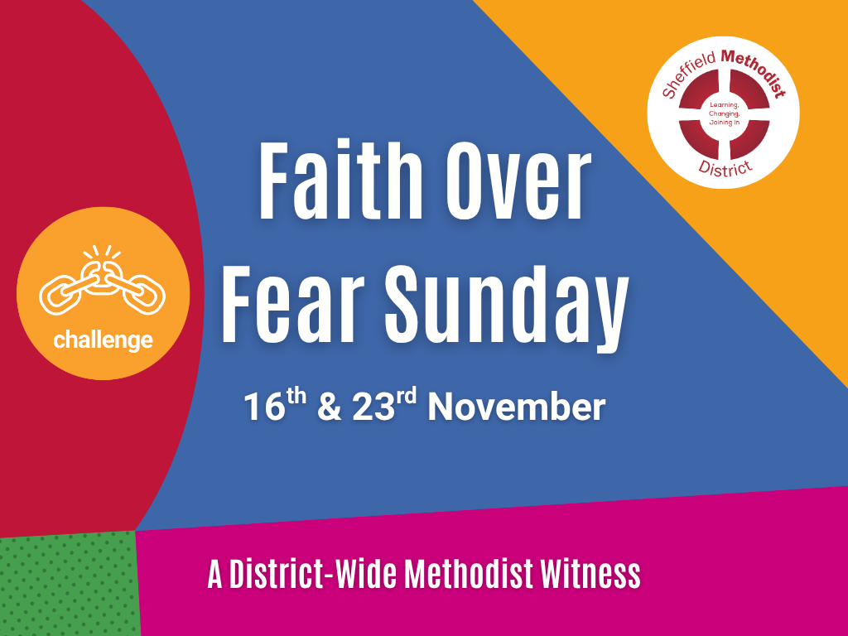

Slide 2
Faith over Fear Sunday
Resources

Slide 3
Call to Worship 1

Slide 4
Psalm 27: 1, 3, 13–14
Leader: The Lord is my light and my salvation, whom shall I fear?
People: The Lord is the stronghold of my life, of whom shall I be afraid?

Slide 5
Leader: Though fears surround us and troubles press in, we will not lose heart.
People: We remain confident of this: we will see the goodness of the Lord in the land of the living!

Slide 6
All: We will wait for the Lord; we will be strong and take heart, and put our trust in God.

Slide 7
Call to Worship 2

Slide 8
Psalm 46: 1–3, 10–11
Leader: God is our refuge and strength, a very present help in trouble.
People: Therefore we will not fear, though the earth should change and the mountains fall into the sea.

Slide 9
Leader: Nations are in uproar, kingdoms fall, but God’s voice stills the storm.
People: “Be still, and know that I am God!”
All: The Lord of hosts is with us; the God of Jacob is our refuge

Slide 10
Call to Worship 3

Slide 11
Psalm 56: 3–4, 10–11
Leader: When I am afraid, I put my trust in You.
People: In God, whose word we praise, in God we trust and are not afraid.

Slide 12
Leader: What can mere mortals do to us, when God is for us?
People: We will walk in the light of faith, not in the shadow of fear.
All: Our hope is in God, whose love endures forever.

Slide 13
Call to Worship 4

Slide 14
Psalm 91: 1–2, 4–5
Leader: Those who dwell in the shelter of the Most High will rest in the shadow of the Almighty.
People: We will say of the Lord, “God is our refuge and fortress, in whom we trust.”

Slide 15
Leader: God will cover us with divine wings; under them we will find refuge.
People: We will not fear the terror of the night, nor the danger that stalks by day.

Slide 16
All: The Lord is our dwelling place; we will rest secure in God’s love.

Slide 17
Responsive Prayers of Praise and Thanksgiving
Option 1

Slide 18
Leader: God of love and light, we come before you in praise and thanksgiving.

Slide 19
You are the One who calms our fears and calls us by name. You breathe courage into our hearts and hope into our weary world.

Slide 20
When fear closes doors, your love opens them wide. When voices of division rise, your Spirit whispers peace. When we feel small or uncertain, you remind us that your grace is enough.

Slide 21
All: We thank you, God of perfect love, that nothing can separate us from you.

Slide 22
Leader: For the beauty of creation, for the kindness of friends and strangers, for the quiet strength that carries us through hard days we give you thanks.

Slide 23
All: Praise be to God, whose love drives out fear and whose mercy endures forever. Amen.

Slide 24
Responsive Prayers of Praise and Thanksgiving
Option 2

Slide 25
Leader: Faithful God, we praise you for the life you give, for your mercy that renews us morning by morning.

Slide 26
You do not ask for empty words or hollow worship, but for hearts alive with compassion and hands ready to serve.

Slide 27
You show us what love looks like feeding the hungry, welcoming the stranger, bringing justice where there is oppression.

Slide 28
All: We thank you, God of justice and grace, for calling us to be your people of courage and compassion.

Slide 29
Leader: For your Church, where love is shared and hope rekindled, for your Spirit at work in hidden places, for moments of forgiveness and new beginning we give you thanks.

Slide 30
All: To you be glory and praise, now and forever. Amen.

Slide 31
Prayer of Confession
Prayer 1

Slide 32
Leader: God of love and truth, we come before you in the quiet of this moment, aware of the ways we have let fear shape our living.
(silence)

Slide 33
When we have stayed silent when your Spirit called us to speak, when we have chosen comfort instead of courage, and safety instead of solidarity forgive us, O God.
(silence)

Slide 34
When we have turned away from our neighbours in need, or passed by those whose stories unsettled us, forgive us, O God.
(silence)

Slide 35
When we have doubted your love for us or failed to see your image in others, forgive us, O God, and restore in us the joy of faith, the strength of hope, and the depth of love that casts out fear.
(silence)

Slide 36
Absolution
Leader: Hear the good news: God’s perfect love drives out fear. In Christ we are forgiven, renewed, and made whole.
All: Thanks be to God. Amen.

Slide 37
Prayer of Confession
Prayer 2

Slide 38
Leader: God of mercy and justice, we come in stillness, bringing the truths we hold quietly within.
(silence)

Slide 39
We confess the times we have failed to love when words have wounded, or when our inaction has allowed harm to continue.
(silence)

Slide 40
We confess the times we have lived small, afraid to risk, hesitant to trust, forgetful of your promise to be with us.
(silence)

Slide 41
We confess the times we have ignored your call to share bread with the hungry, to bring the homeless poor into our homes, to loosen the bonds of injustice.
(silence)

Slide 42
God of grace, forgive what has been, heal what is broken, and open our hearts to the fearless love of Christ.
(silence)

Slide 43
Absolution:
Leader: Hear the words of grace: God’s mercy is deeper than our imagining, God’s love wider than our fear. In Christ, we are forgiven and made new.
All: Thanks be to God. Amen.

Slide 44
Prayers for Others
Option 1 - Candles

Slide 45
Candle 1 – For those living in fear:
For those who wake in the night afraid of what tomorrow may bring….
For those who have fled their homes…
For those who long to live without fear, we light this candle of courage.
(silence)

Slide 46
Candle 2 – For those silenced or unheard:
For the voiceless, the marginalised, the unseen…
May our listening become your justice.
(silence)

Slide 47
Candle 3 – For the Church:
That we may choose faith over fear, welcome over walls, and love over indifference.
(silence)

Slide 48
Candle 4 – For our communities and leaders:
For wisdom, humility, and compassion in every decision that shapes lives.
(silence)

Slide 49
Candle 5 – For creation and the future:
For the healing of the earth, for the courage to live gently and generously.
(silence)

Slide 50
God of love, in your light we find our peace.
Hear our prayers, spoken and unspoken, and make us bearers of your fearless love.
Amen.

Slide 51
Prayers for Others
Option 2 - The Prayer Tree of Welcome and Courage

Slide 52
Introduction
Today we bring before God all those in our communities and world who live with fear.
Fear of being unwelcome, unheard, or unsafe.

Slide 53
We remember our neighbours from other countries, faiths, and backgrounds; those who are seeking home, those who have faced rejection, and those who wonder if there is still a place for them.

Slide 54
As we pray, we will hang our prayers like leaves on this tree, signs of life, courage, and hope.
Prayers are written and brought forward.

Slide 55
Leader: This is our prayer tree of welcome, a reminder that the love of God grows where people choose faith over fear, and welcome over exclusion.

Slide 56
God of all life, may this prayer tree stand as a living sign of your Kingdom growing among us — branches of compassion, roots of justice, and leaves of hope for all who pass by.

Slide 57
All: Through Jesus Christ, our shelter and our peace. Amen.

Slide 58
Closing and Departing

Slide 59
Blessing (1)
Go in peace, to live with courage, to speak words of hope, to build communities of welcome and grace.

Slide 60
May the God who casts out fear fill your heart with love; may Christ who walks beside you give you strength for the journey; and may the Spirit who dwells within you make you a sign of peace in the world.
Amen.

Slide 61
Blessing (2)
Go now, people of faith, to choose love over fear, compassion over indifference, justice over silence.

Slide 62
May God’s light lead you, Christ’s compassion hold you, and the Spirit’s fire empower you to live as people of fearless love.
Amen.

Slide 63
Celtic Style Blessing (3)
May the peace of God surround you, the strength of Christ uphold you, and the tenderness of the Spirit breathe through you.

Slide 64
May courage rise when fear whispers, and may love guide you home each day. Go in faith, to walk humbly, act justly, and love mercy today and always.
Amen.

