Slide 1
Lay Employees’ Retreat
Session 1 – Who is God for us?

Slide 2
Image of God
People who believe in the same God prioritise different aspects, characteristics or faces of that God.

Slide 3
Discernment Vs Decision Making
“Our approach to decision making should be different from secular models’ While those secular models, decision making processes, facilitation techniques are all good, and we use them in our discernment process, they are structures, not foundations.”(Barton 2012)

Slide 4
Some basic principles
God is real
God is lovingly and creatively active in the world
God wants to be in communication with us

Slide 5
Image of God
God is busy
God is a loving parent
God is disappointed
God is delighted

Slide 6
Image of God in decision making
Some common misleading images are:
God is interested and observing, but not directly involved.
God will only love me if I make the right decision.
God has set this as a test to see if I am up to standard.
God has given me/us an instruction manual (the Bible) and expects us to figure it out on our own.
God is waiting impatiently for us to make up our minds. God is in a hurry.
God has the script, but is refusing to let me see it.

Slide 7
A more helpful image might be:
God is loving me, leading me, in the decision with me, helping me in the process.
Learning to accept a good image of God will take time (and the negative one will sneak back when individuals are under stress)– but being aware of what is happening and naming what it helps

Slide 8
Understanding of Self
How many different types of knowing dwell inside you?
What are the different facets of your wisdom? And which ones do you feel comfortable sharing and which ones do you keep shelved away.
How might your family/church/community be poorer if your hidden wisdoms never get air time?

Slide 9
Types of Prayer
A commitment as discernment begins with prayer

Slide 10
‘In tune with God’
https://youtu.be/2rd5shtgPRg

Slide 11
Different ways of praying
How we pray will relate to:
our personalities.
our faith histories – how have we seen/heard other people pray? How have we been taught to pray?
our understanding of who God is.
the unique relationship that every individual has with God. Just as in families, each child has a different relationship with their mother, in the Christian family, each of us has a unique experience of God.

Slide 12
Intercessory prayer
theguardian.com/uk
For a moment in quietness, notice which headline attracts your attention.
Think of what you would want to ask for from God for that situation.
Write down a prayer in a few words or a sentence, asking for God to help in this situation

Slide 13
Praying with silence
https://www.youtube.com/watch?v=JHCKuIlB_V0

Slide 14
Praying with music and maybe movement

Slide 15
The Examen

Slide 16
Closing Prayer
‘Oh God, you search me and you know me’ (Psalm 139:1)
What does God find?
What does God know?

Slide 17
Vocation
“Calling emerges as the result of a dynamic relationship between the ‘Caller’ and the ‘Called’” Walter Bruggeman

Slide 18
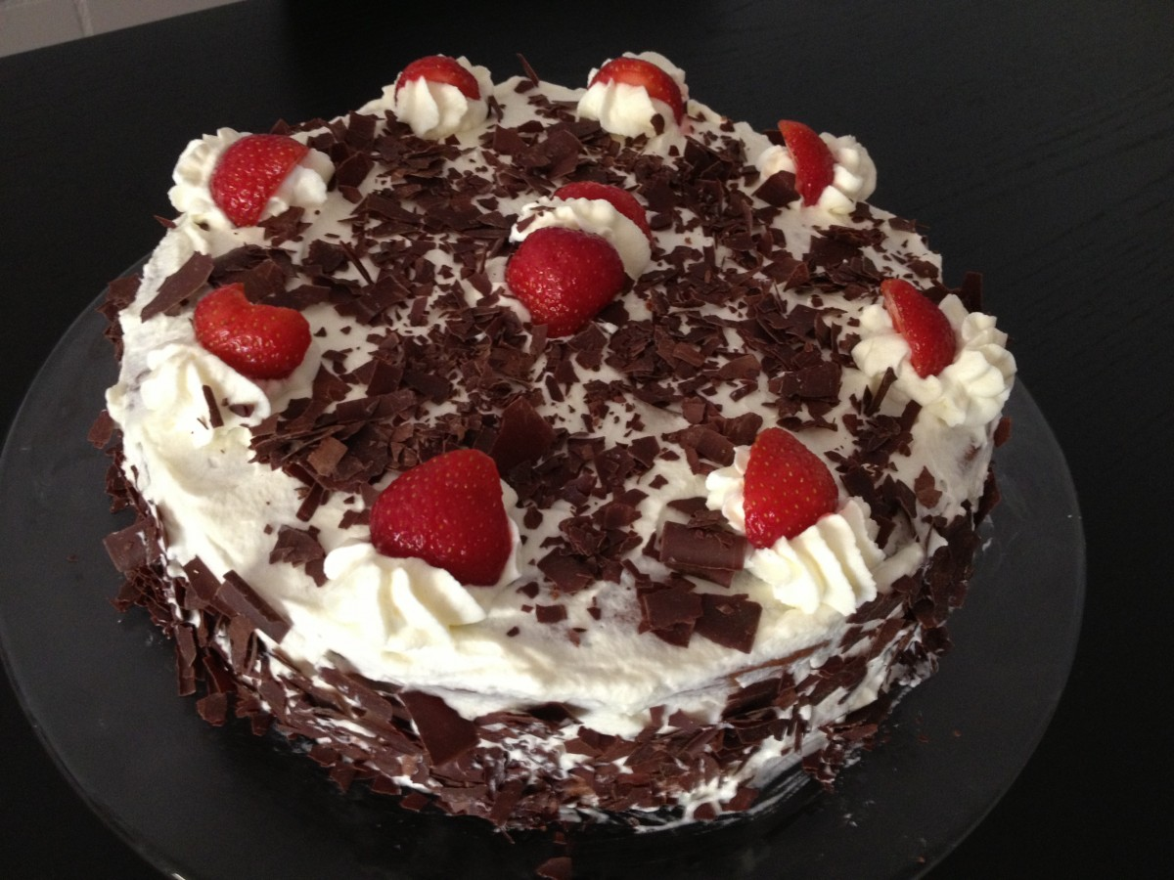

Slide 19
“The outliving of vocation, our work, is only a means of putting our love for Christ into action. Vocation is, in itself, simply belonging to Christ.” Peter Monson

Slide 20
Definitions
Calling is a sense of a prompting, from God, to be or do something.
Discernment is working out what ‘the something’ might be. This is internal, and external – what we come to ‘know’ through prayer, and what others tell us or indeed what our current context dictates.
Vocation is a way of living our lives that enables us to ‘do and be’ the something. Some have a vocational golden thread running through how they live their lives, eg always a healing ministry. For others the context changes our vocations a lot.

Slide 21
McFly - All About You (Official HQ) - YouTube

Slide 22
Gerard Hughes says “God’s great desire for you is your deepest desire”
Ada Maria Isasi-Diaz calls it
“the kin-dom of God”.
Andrew Hayes “Discerning God’s will is to discern action in present and tangible ways which evidence God’s presence”

Slide 23
Doubt is an integral part of calling. The process of finding one’s callings will necessarily be accompanied by doubt and uncertainty; in fact, the ambiguous and shadowy nature of vocation can be a positive feature.

Slide 24
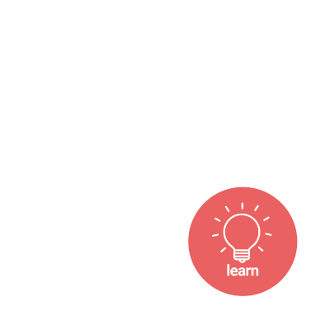





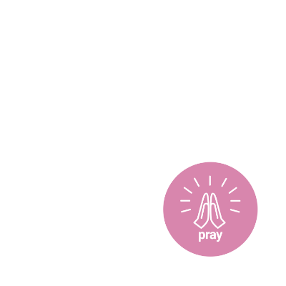





A Methodist way of Life
A vibrant, healthy, holy, discipleship journey needs balance and variety

Slide 25
“The place God calls you to, is the place where your deep gladness and the world’s deep hunger meet.”
Frederick Buechner
“Go not only to those that need you, but to those that need you most”
John Wesley

Slide 26
Activity
List the identities, interests, experiences that have shaped you.

Slide 27
Lectio Divina
John 15: 5-7

Slide 28
Developing Discernment
Noticing your own experience
Remember a time when you felt very close to God. What did it feel like?
Share responses
Remember a time when you felt far away from God. What did it feel like? (give 2 minutes quiet)
Share responses

Slide 29


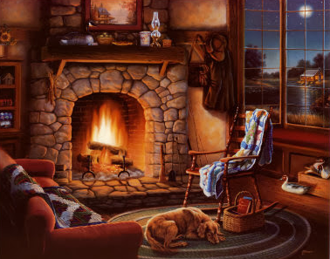
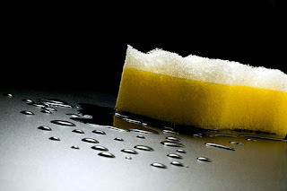
That which is of God (Consolation)

Slide 30




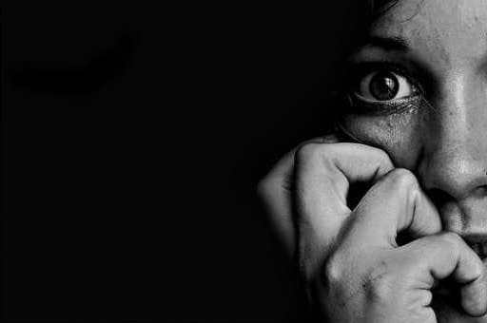
What is not of God (Desolation)

Slide 31
Telling the difference:
By where they are leading
By the orientation
Does God ultimately benefit from what is happening
The beginning, the middle and the end is good
The tone of voice

Slide 32
‘Inordinate attachments’
The desire to look productive, innovative or dynamic.
The desire to be noticed.
The desire to be comfortable.
The desire to work with certain people/groups or not work with certain people/groups.
The desire for things to stay the same, or the desire for change for the sake of change.
They often take the form of possessions, power or status.

Slide 33
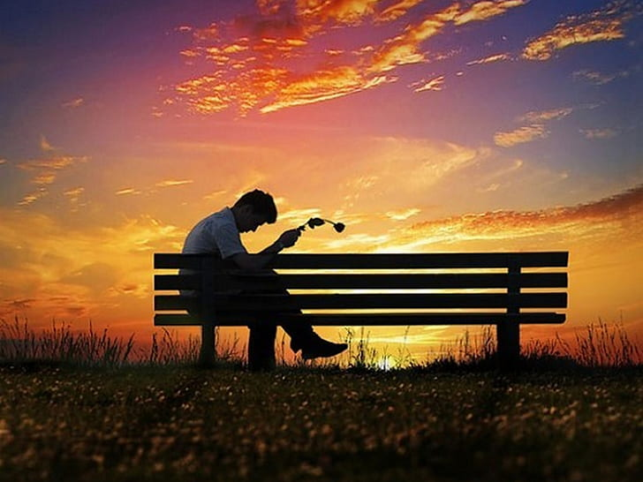
Personal Reflection

Slide 34
The Methodist Quadrilateral
Scripture
Tradition
Reason
Experience
Have you had experience of decision making that tried to make room for all four segments? What was that like?

Slide 35
What decision?
Discernment is not ‘what is God asking of us’ but ‘where am I/are we being invited to join in with what God is doing in this place’.

Slide 36
Facts
Part of fact gathering is admitting to what we don’t know so that we can learn.
Realistically think through your own gifts and abilities. What do you do especially well? What are your limitations?
Accepting ‘what is’ is not defeatism. It is wisdom. Whose voice are you not hearing?
Widening your perspective can give a clearer view.
As you listen to the facts, do so discerningly. Where do you feel drawn? What unsettles you? What fills you with hope?

Slide 37

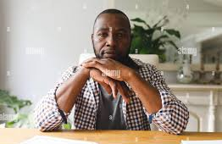
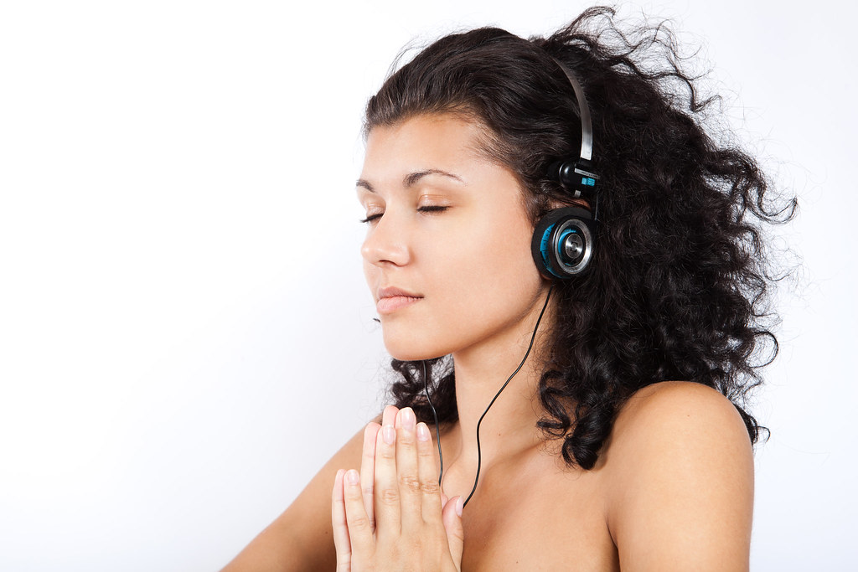
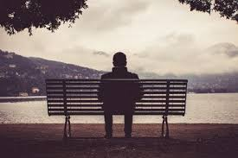

Timeframe

Slide 38
Stages of discernment
  the initial recognition that a decision needs to be made.
  Who needs to be involved?
  What is the decision that needs to be made?
  How will we gather the information we need (and a pause while it is gathered)?
  How will we listen well to each other?
  What methods will we use to decide?
  How will we ensure that the decision continues to feel right?
  How will we implement the decision?

Slide 39
Session 4
What is God saying to you
Oceans - Hillsong United (cover) by Genavieve Linkowski | Collab w/ Anthem Worship + @MassAnthem

Slide 40
Some modes of decision making
Sudden clarity/Blinding flash
Paying attention to consolation and desolation
Working it Out

Slide 41
Self in decision making – Personal Reflection
Who are you when you’re at your very best?
What is the version of yourself that you present to others?
What parts of yourself do you silence?
What aspects of who you are might God be inviting you to risk sharing with others?

Slide 42
Knowing yourself
Do you want to open up more and more options, or do you want to narrow options as soon as possible?
Do you prevaricate and procrastinate as long as possible or rush to a conclusion?
Which do you find more uncomfortable – certainty or uncertainty?
What are your preferred ‘ways of knowing’ and what ‘ways of knowing’ do you tend to discount or dismiss?
In the Methodist quadrilateral of scripture, tradition, reason and experience, which do you tend to rely on more, which might you make more effort to include in your consideration?
What is your wisdom that you find easy to share with the group, and what wisdom are you more reluctant to share?
How might your decision making personality help and hinder wider group decision making?

Slide 43
God of all time
I believe that my past, present and future are in your hands.
God of all life,
I believe that there is nowhere I may go
where you are not there before me.
God of all place,
I believe that the vastest movements of the cosmos
and the most intimate thoughts of the human heart
are both of concern to you.
God of all experience,
I believe that the heights and depths of human aspiration and anguish are known alike to you.
Help me to find my voice and to sing my song:
in the time you have given me
in the places that I find myself
in the life that is mine to live.
(Slee, 2004, p. 68)

