Slide 1
Theme – Wellbeing in a time of Change

Slide 2
First | We are going to consider change and the impact of change on both individuals and society
Second | We are going to consider what we understand by wellbeing
Third | We are going to consider what might help us better manage wellbeing – generally and specifically in relation to change and our roles in ministry.
Fourth | I am going to share some insights I have gained into the world of mental health
Fifth | I am going to share a little bit more about the PeerTalk charity

Slide 3
Section One
Considering change and the impact of change on both individuals and society

Slide 4
 | 1978 | 2020
Global population | 4 292 097 502 | 8 021 407 192
UK population | 56 200 000 | 67 790 000
Immigration | 72 000 | 1.2 million immigrated 479 000 emigrated Net – 764 000
House Price | £14 279 | £294 000
Salary | £3 269 | £33 061
Prison pop | 41 796 | 80 798
Registered vehicles | 18 million | 40.7 million
Phones | 35% of households | 81.7 million

Slide 5
 | 1978 | 2020
Number of Methodist Churches | 8 206 | 4 004
Number of active members | 506 456 | 164 000
Number of Ministers |  | 3 459

Slide 6
What do you identify as the top three changes that you consider to be having the greatest impact (positive or negative) on individual (or societal) wellbeing in 2025?

Slide 7
Section Two
To consider what we
understand by wellbeing

Slide 8
Wellbeing is not just the absence of disease or illness. It's a complex combination of a person's physical, mental, emotional and social health factors. Wellbeing is strongly linked to happiness and life satisfaction. In short, wellbeing could be described as how you feel about yourself and your life.

Slide 9
Wellbeing is determined by social, economic and environmental conditions. Well-being encompasses quality of life and the ability of people and societies to contribute to the world with a sense of meaning and purpose.

Slide 10
Wellbeing can be understood as how people feel and how they function both on a personal and social level, and how they evaluate their lives as a whole

Slide 11
Well-being is the experience of health, happiness, and prosperity. It includes having good mental health, high life satisfaction, a sense of meaning or purpose, and the ability to manage stress. More generally, well-being is just feeling well

Slide 12
Wellbeing is a combination of our physical self, our financial security, loving what we do each day, the quality of our relationships and contributing to our communities. Wellbeing is about a mindful, purposeful life. And it looks different for every person.

Slide 14
What do we offer to our church communities as tools, exercises, practices or disciplines that raises the degree of spiritual wellbeing, that offers a pathway to a deeper sense of Shalom. What are these exercises, practices and disciplines and how do we offer them?

Slide 15
Section Three
Maintaining wellbeing in a time of change
First a general look at maintaining wellbeing.
Then we will explore what the specific ‘changes’ might be in relation to ministry.
Then we will look at how we maintain wellbeing in relation to those changes.

Slide 16

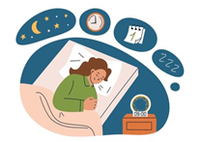

Maintaining Wellbeing The Fundamentals
Diet | Having a healthy diet and eating regime
Sleep | Getting all the sleep you need
Exercise | Engaging in appropriate exercise

Slide 17
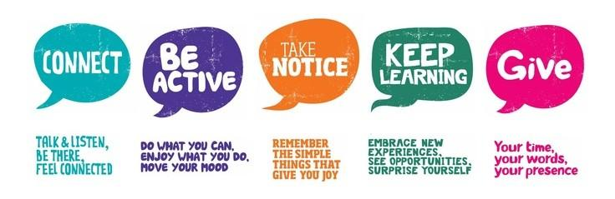
Maintaining Wellbeing The Basics

Slide 18
Then there are many techniques that people use and find helpful for maintaining and improving wellbeing

Slide 19
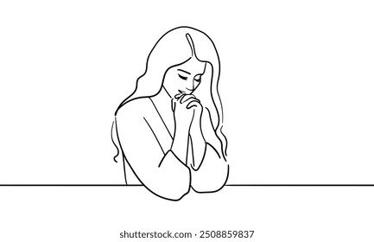
Meditation

Slide 20
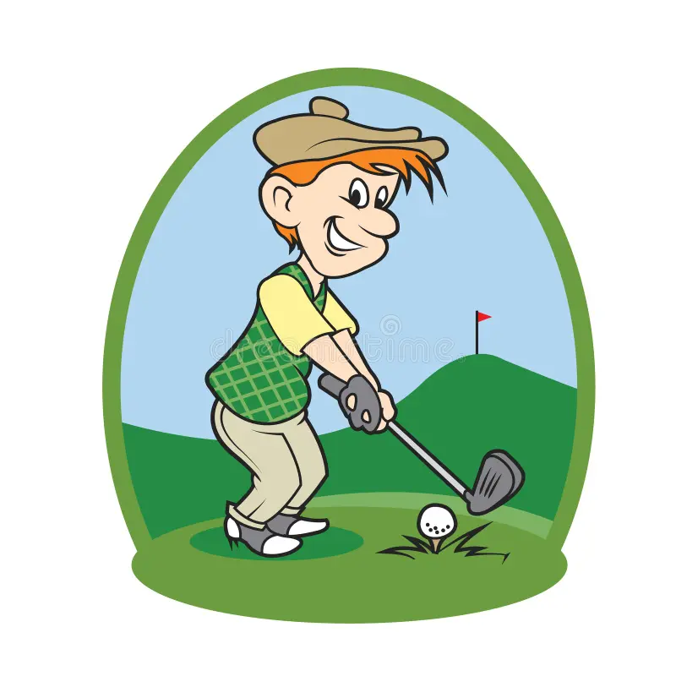
Distraction

Slide 21
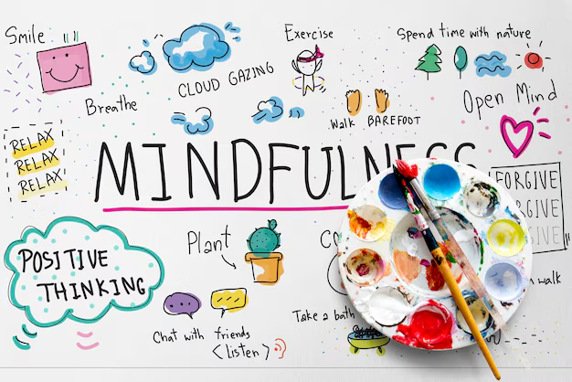
Mindfulness exercises

Slide 22

Thankfulness Journal

Slide 23

Taking a break - a holiday

Slide 24

Treating yourself to something you enjoy

Slide 25

Colouring books

Slide 26

Go ‘off grid’ for a while (no phone or email)

Slide 27

Have a relaxing bath

Slide 28
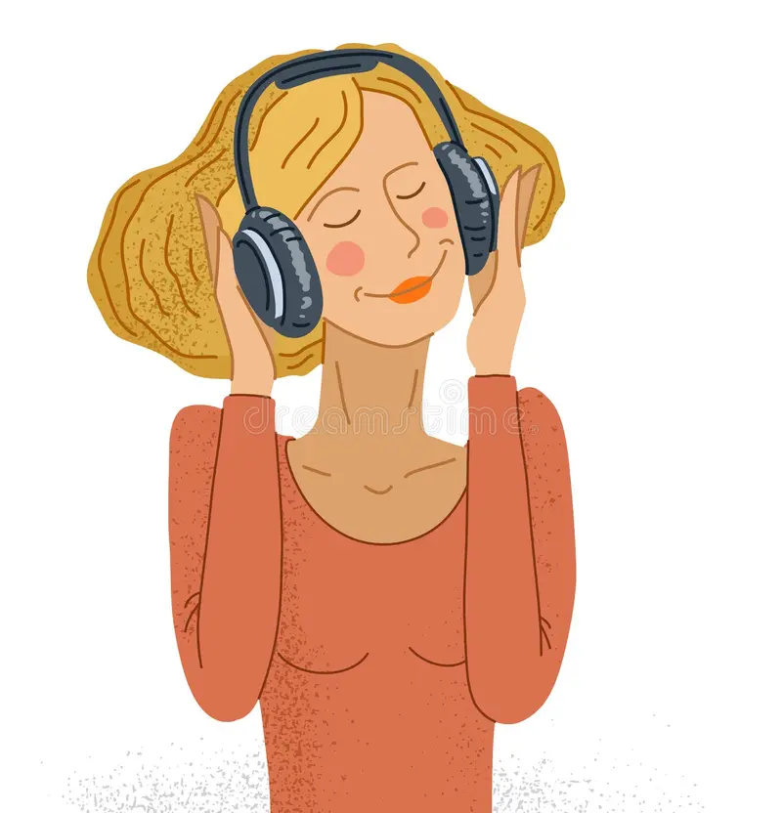
Listen to relaxing music

Slide 29
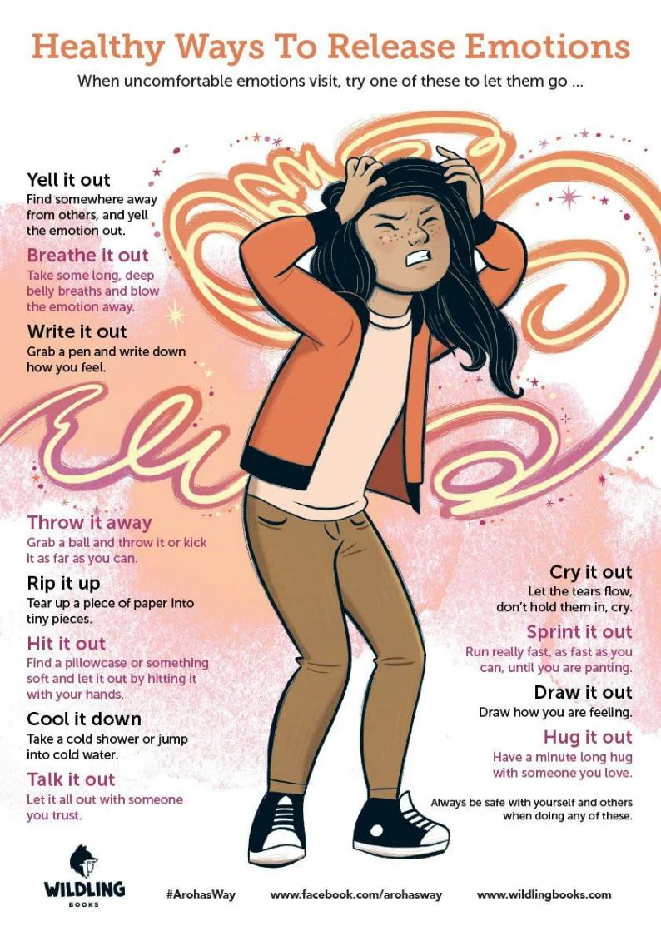
Let out your feelings on paper
or shout them from a mountain

Slide 30

But the five basics for everyone are…
Being connected with others
Learning new things
Being active
Taking notice
Giving
Be a CLANGER

Slide 31
Section Four
Share some insights I have gained into the world of mental health

Slide 33
Identify your three strongest positive emotions experienced in your role as a presbyteral minister
Identify your three strongest negative emotions experienced as a presbyteral minister

Slide 34
Some insights I have gained into the world of mental health

Slide 35
Clip – Professor Sami Timini – No known biological casuses

Slide 36
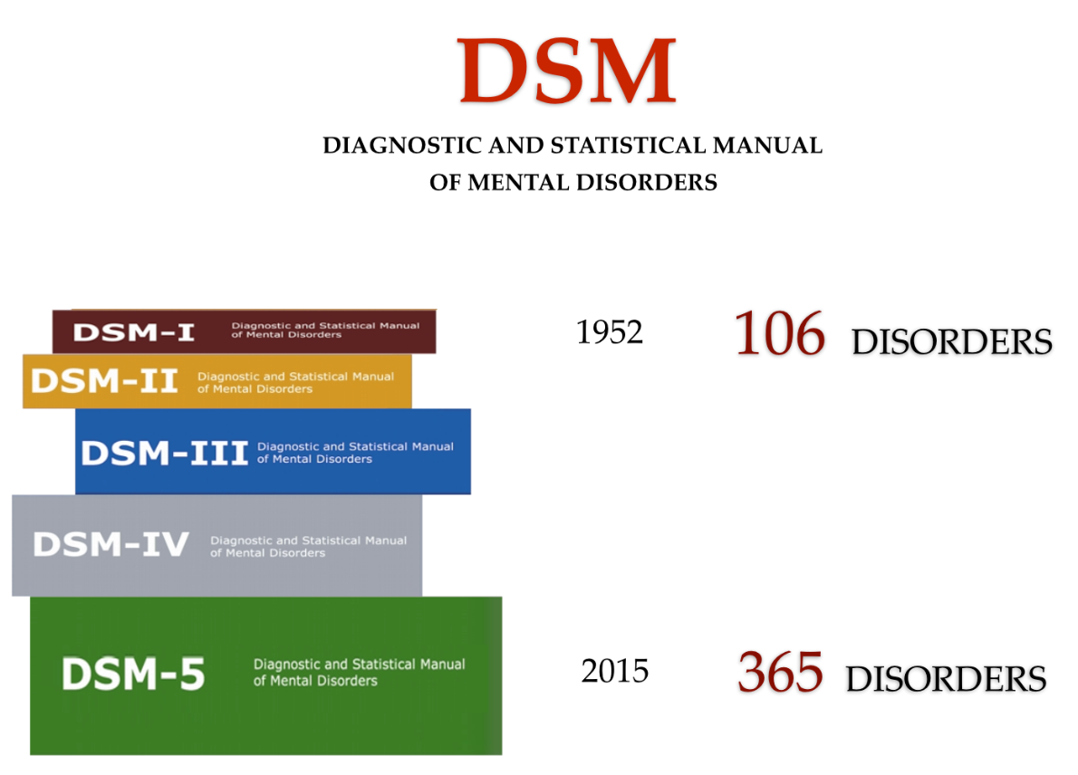

Slide 37
Homosexuality was classified as a mental disorder in the Diagnostic and Statistical Manual of Mental Disorders (DSM) beginning with the first edition, published in 1952 by the American Psychiatric Association (APA). This classification was challenged by gay rights activists during the gay liberation following the 1969 Stonewall riots, and in December 1973, the APA board of trustees voted to declassify homosexuality as a mental disorder. In 1974, the DSM was updated and homosexuality was replaced with a new diagnostic code for individuals distressed by their homosexuality, termed ego-dystonic sexual orientation. Distress over one's sexual orientation remained in the manual, under different names, until the DSM-5.

Slide 39
Clip – Professor Sami Timini – Are Diagnoses helpful

Slide 41
Consider the statement that it is better for people to be asked ‘what happened to you’ to explain their emotional struggles such as depression and anxiety, rather than, ‘what’s wrong with you?

Slide 42
Section Five
A Little bit about the
PeerTalk Charity

Slide 43


Aware in Ireland
National network of 40 support groups.
Established for over 30 years
Encouraging and supportive

Slide 44
2016 - PeerTalk becomes a charity
Trustees - Emphasis being organisationally robust and ‘clinically credible’
Aim to be A* in everything we do.

Slide 45
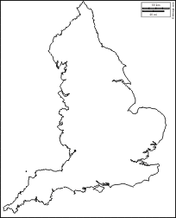
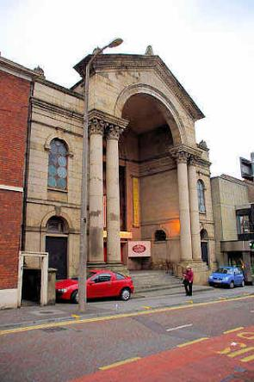
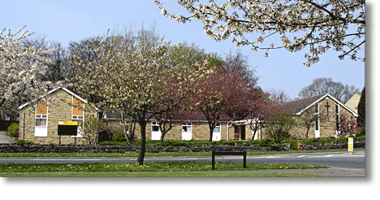
2017 - First support groups start in
Bradford and Preston

Slide 46

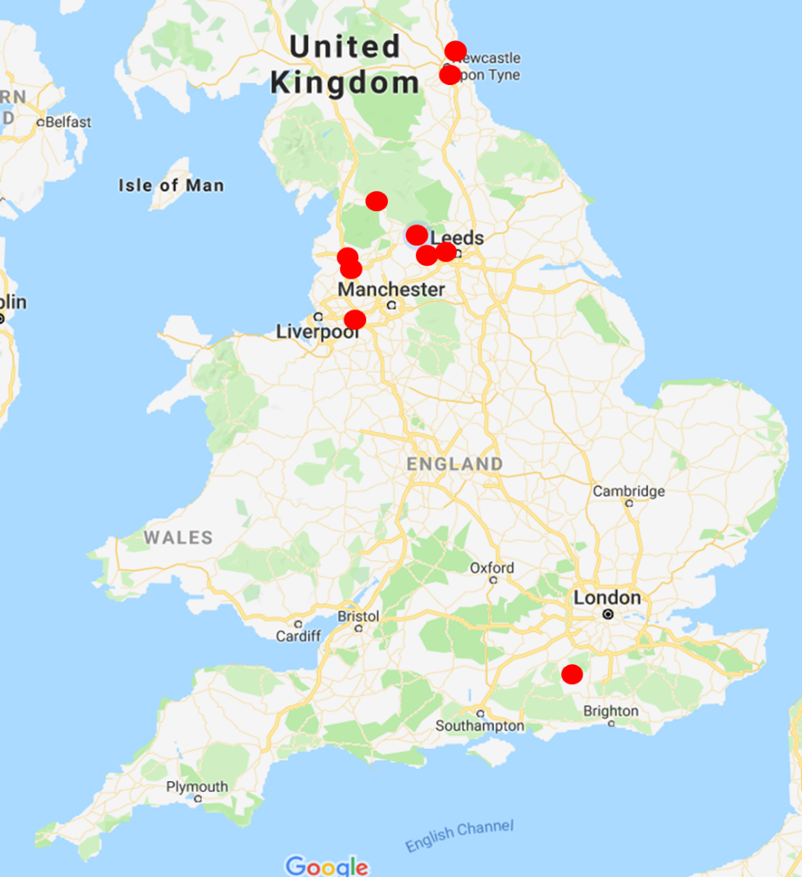
Our PeerTalk Support Groups
North Shields
Whitley Bay
Gateshead
University of Sunderland
Batley
Leeds Beckett University
Huddersfield
Farnham.
Guildford
Bordon
.
Stockton
Skipton
Bradford
Preston
Preston 2
Knowsley
Warrington
.

Slide 47

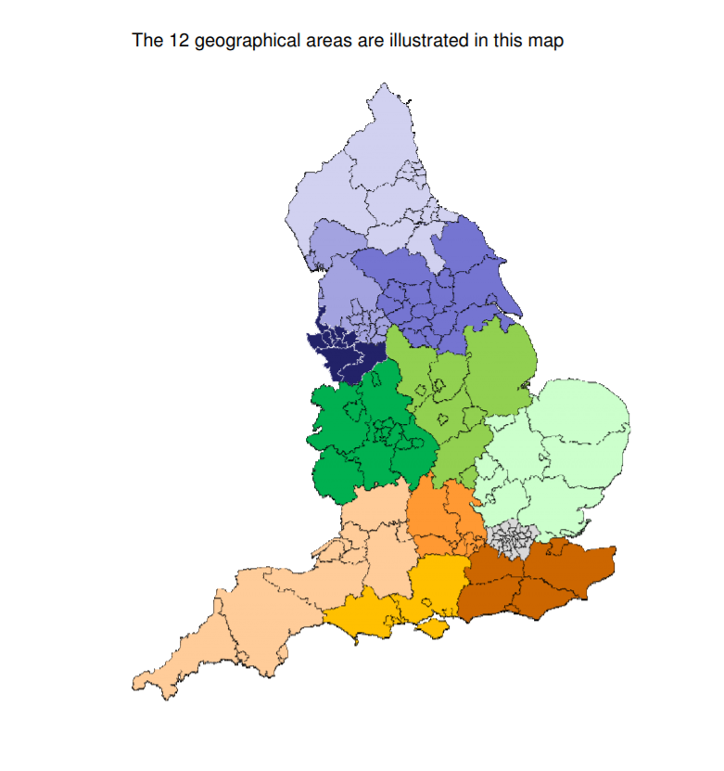
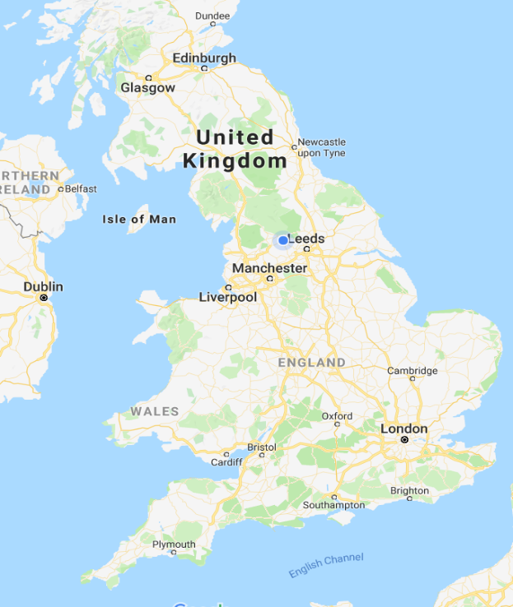
The Vision –
There are 12 NHS Clinical Networks … Could we have ten PeerTalk groups in each network? - 120 groups in ten years?

Slide 48
Thank you!

