Slide 1
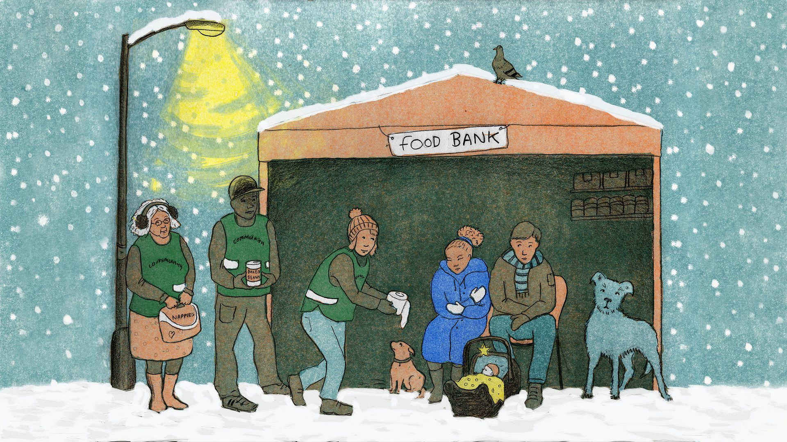


Life on the Breadline:
Christianity and Poverty in the 21st Century
Highfield Trinity
Methodist Church, Sheffield
Dr Chris Shannahan &
Dr Stephanie Denning

Slide 2
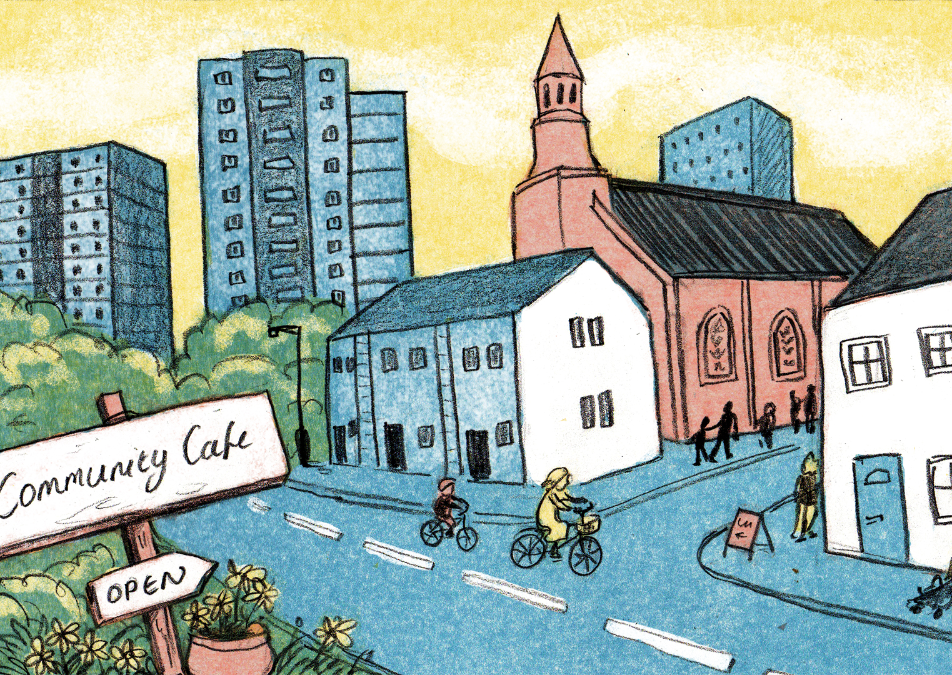
Life on the Breadline: today’s overview
The aim of the research
The nature of poverty and austerity in the UK
Life on the Breadline methodology
Christian approaches to poverty
Challenges for the Church
The Anti-Poverty Charter

Slide 3
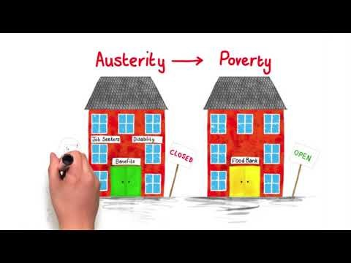
Life on the Breadline: the aim

Slide 4
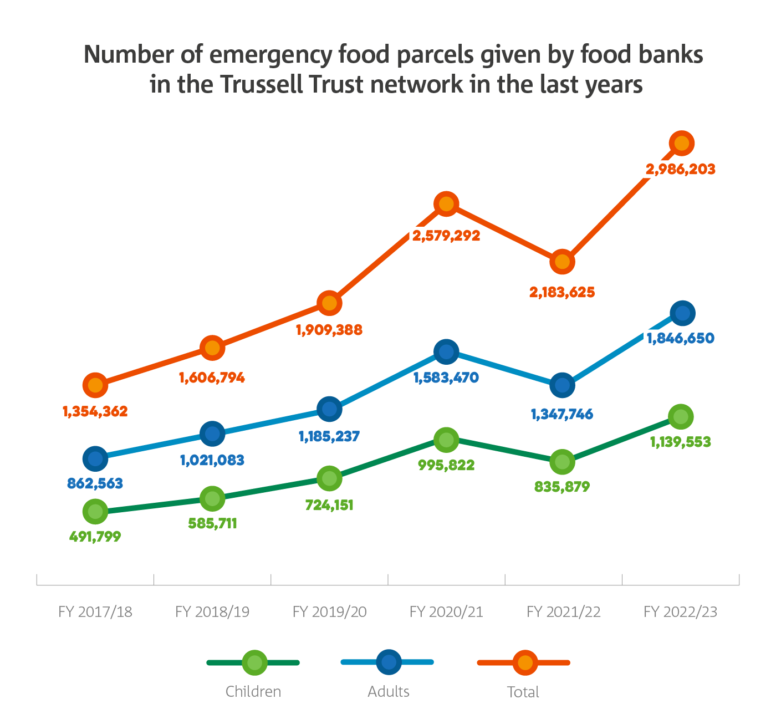
The nature of poverty
Around 1 in 5 people in the UK are living in poverty; 14.4 million people (JRF, 2024)
  8.1 million working-age adults
  4.2 million children (1 in 4 children)
  2.1 million pensioners
Urban and rural poverty and hardship
Poverty is multi-dimensional and not just about food
Increase in the number of 3 day emergency food supplies given by Trussell Trust foodbanks (Trussell Trust, 2023)

Slide 5
A picture of poverty in 2024
Foodbanks
Homelessness
Rough Sleeping
Not enough money to live on
Long-term deprivation
Unemployment
Low Pay
Suffering from poor health
People living in poor quality housing
Insecure jobs
Rural and urban
Hardship and struggle

Slide 6
Austerity in the UK
“Austerity means that life’s been tougher and harder for many people.”
Bishop Paul Butler, Church of England, interview, 2020
The different meanings of austerity:
  Economic austerity
  Personal austerity
  Self-restraint
  Often not everyday language
The unequal impact of austerity
Life on the Breadline’s Austerity timeline
“Me personally [affected by austerity]? No. I am very lucky – middle class, middle aged, the right demographic.”
Interview with B30 Foodbank volunteer, 2019
“I think it sounds like a posh word that the government use.”
Jim, research participant, interview, 2020

Slide 7
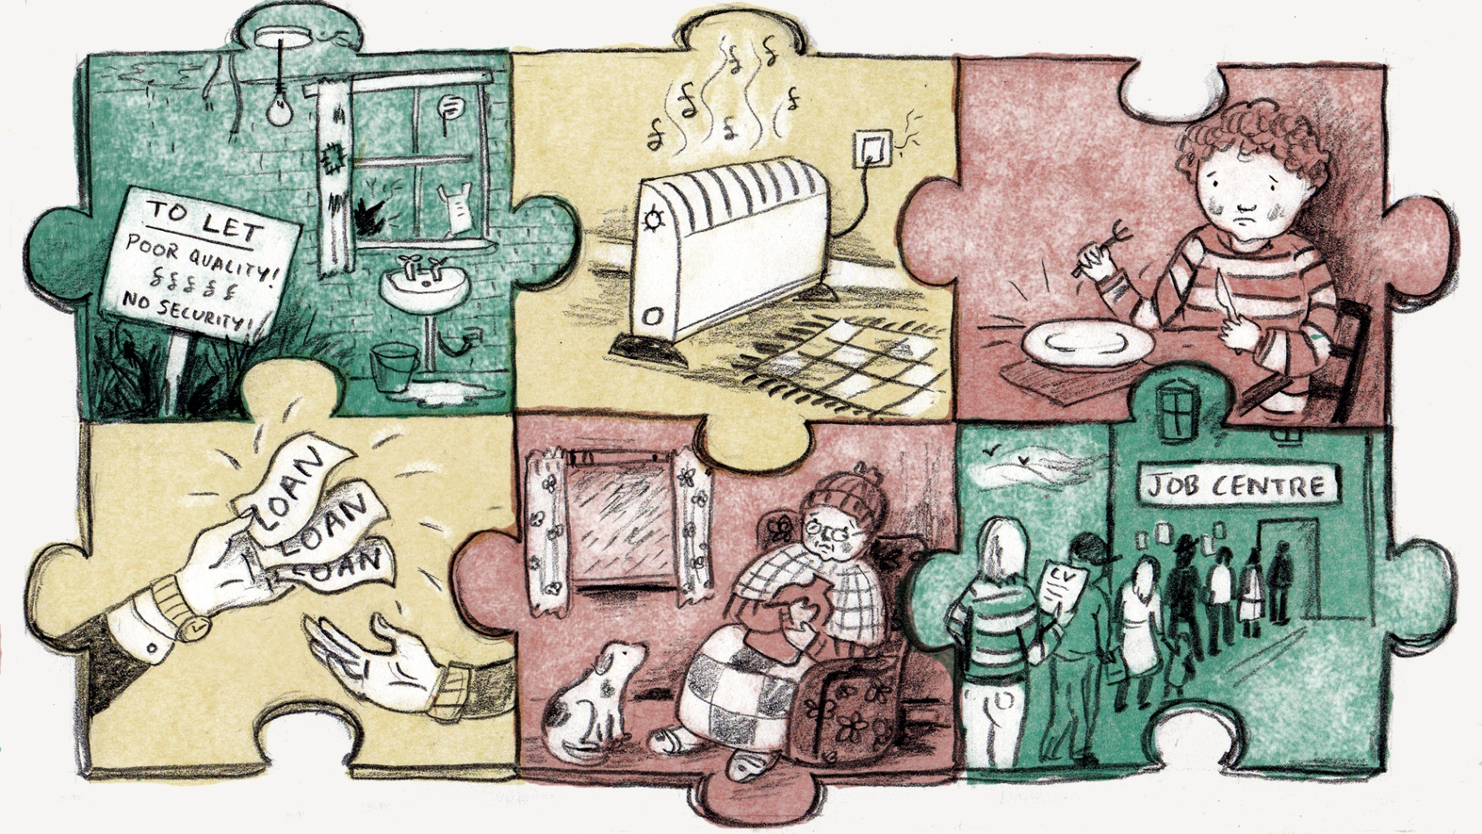
Austerity in the government
Austerity measures began in 2010 by the Conservative-Liberal Democrat coalition government and have continued since then
This followed the 2008-9 global economic crisis
Key measures have included:
  Universal Credit began to be
  rolled out from April 2014
  Benefit rates were frozen for
  4 years from April 2016
Has austerity finished?...
Poverty and austerity as structural injustices

Slide 8
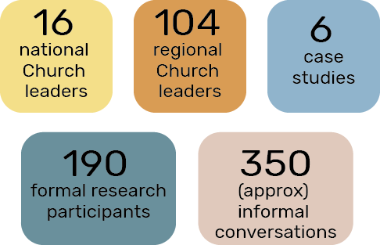
Life on the Breadline’s methodology
Methods used in the research:
  Interviews with national Church leaders
  Surveys with regional Church leaders
  Local case studies
The Life on the Breadline research participants

Slide 9
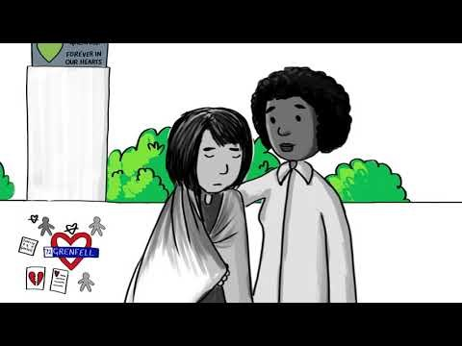
Life on the Breadline: case studies

Slide 10
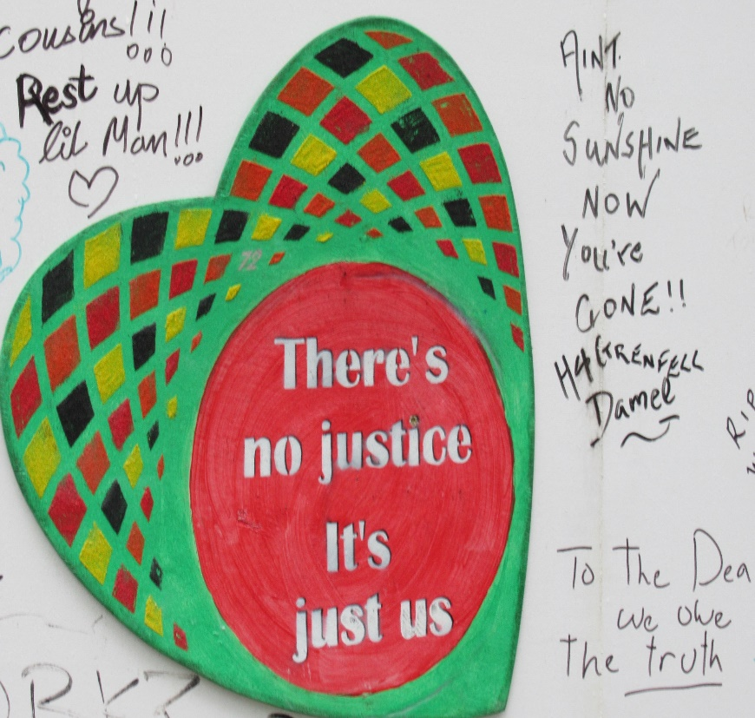
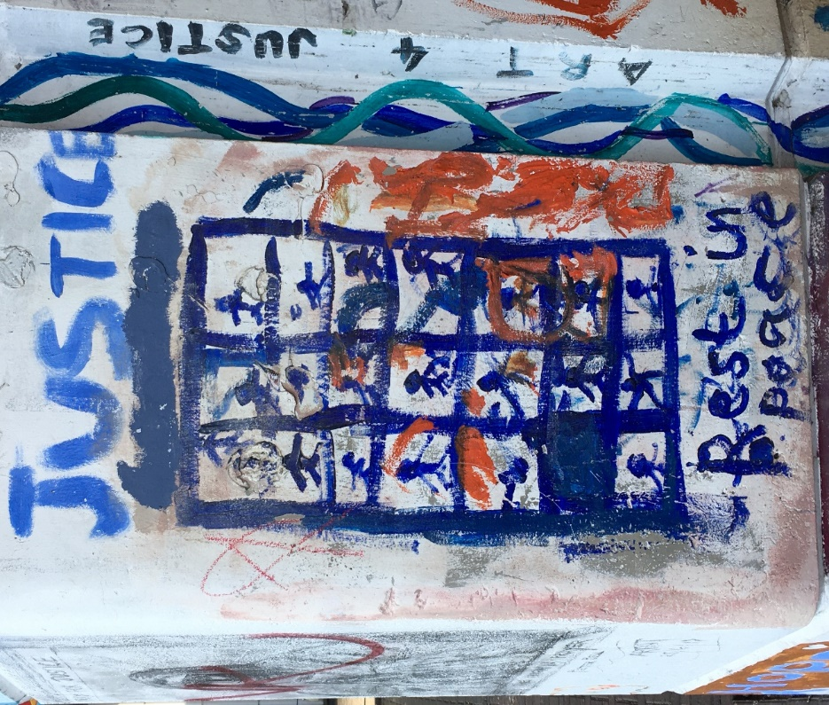
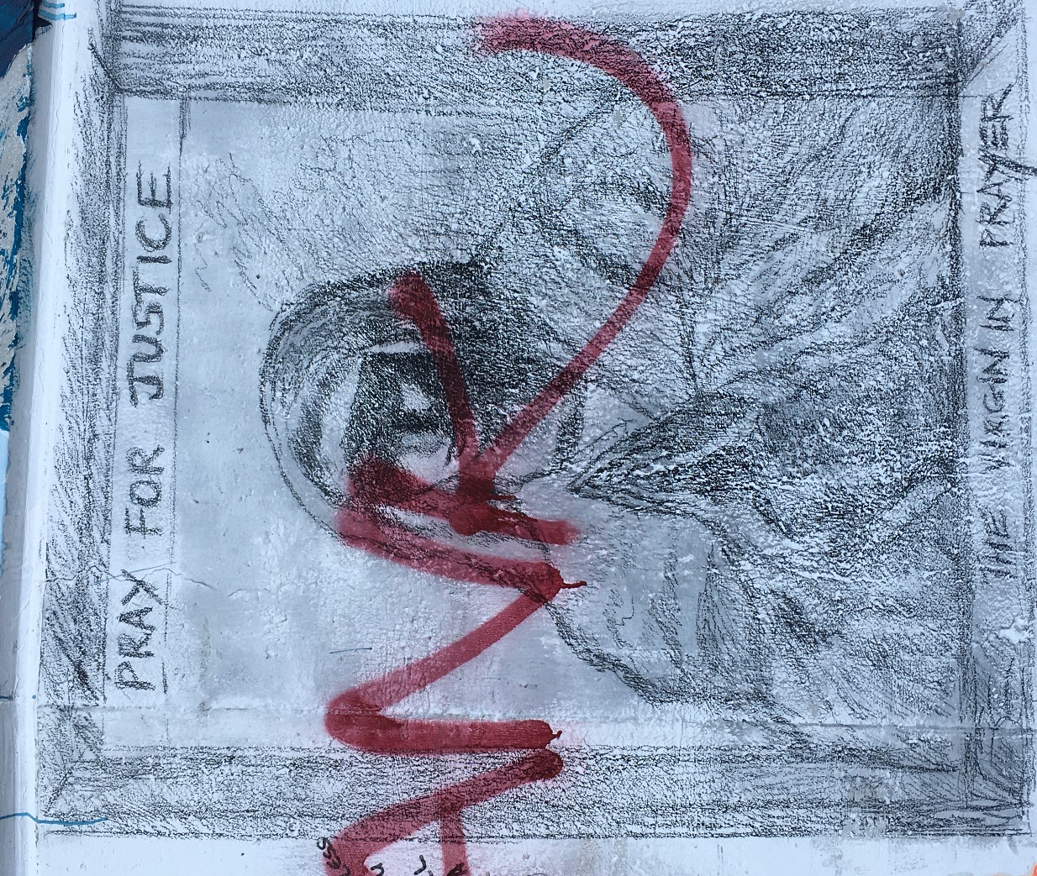
Austerity – Our Kairos moment

Slide 11
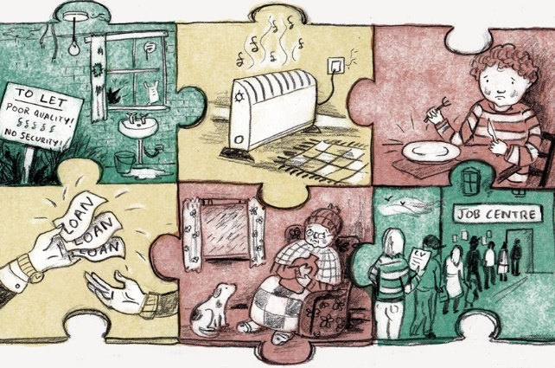
The Octopus of Poverty ….
Poverty is multidimensional but our responses are often one dimensional
Poverty is violence – slow, structural, cultural – Damaging us to the core.
Poverty is systemic - but we individualise and moralise it.
‘Skivers’?
‘Strivers’?
‘Deserving’?
Tamez - “In the Bible poverty represents the degradation of the human being, a seizure of the divine image in the person.”
‘Undeserving’?

Slide 12
Four Christian Approaches to Poverty
Self-Help
Campaigning &
Advocacy
Community Building
Caring
How does the Church use its influence and presence?
Reflect differing ethical, missiological, ecclesiological & theological traditions
Fluid responses – Converge + diverge. Not fixed Ideal Types

Slide 13
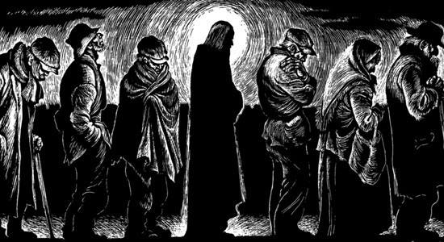
Caring: Church as Servant Community
“Jesus began to wash his disciples feet.” (John 13)
Pastoral care, human flourishing & common good
Foodbanks, Breakfast Clubs, Warm Banks…
Welfare not Justice – Matthew 25
Political intervention – “a bandage”, not a “spoke in the wheel…”
Immense value - can be objectifying

Slide 14
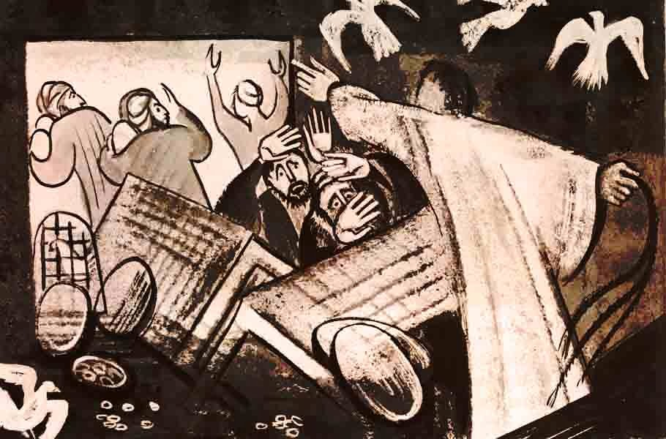
Campaigning: Church as Liberative Movement
Marginalised ‘prophetic’ tradition – Isaiah 58:10, Jeremiah 22:16, Luke 4:16ff
Social justice trumps welfare
“…Jesus had a bias to the poor.” [Richard Fraser Church of Scotland]
Living wage, housing justice, pay-day loans….
Liam Purcell [Church Action] - “It’s not enough to do local social action”
Archbishop of Wales: “The Church has a duty to speak up on behalf of people who are unjustly treated.”

Slide 15

Self-Help/Enterprise: Church as Enabler
Evangelical & Pentecostal churches
Education: route out of poverty
Business start-ups > Financial empowerment > Enabling resilience
Prosperity Gospel temptations [SPAC Nation]
Individualised: leaves systemic injustice intact.
“promotion of neo-liberal economic thought, which has had adverse consequences for Black communities in Britain” [Robert Beckford]

Slide 16

Community Building: Church as Fellow-traveller
Incarnational spirituality: God with us….
Bottom-up community building – Avoids “rescuer language”
Ecclesiology of Solidarity – No parachuting in: Rooted, long-term
ABCD – What is strong not what is wrong.
Challenging poverty of identity - stigma & low self-esteem:
Can it “transform structural injustice”?

Slide 17
Five Challenges to the Church
Assert God’s Preferential Option for the Poor more clearly and more publicly.
Reverse disengagement from the daily realities of austerity.
Use social capital to support prophetic campaigning for structural change.
Use worship & small groups to challenge cultural violence that underpins poverty.
Move beyond charity to politics

Slide 18
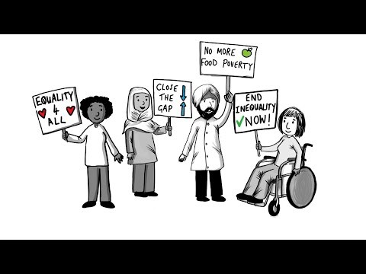
The Anti-Poverty Charter

Slide 19
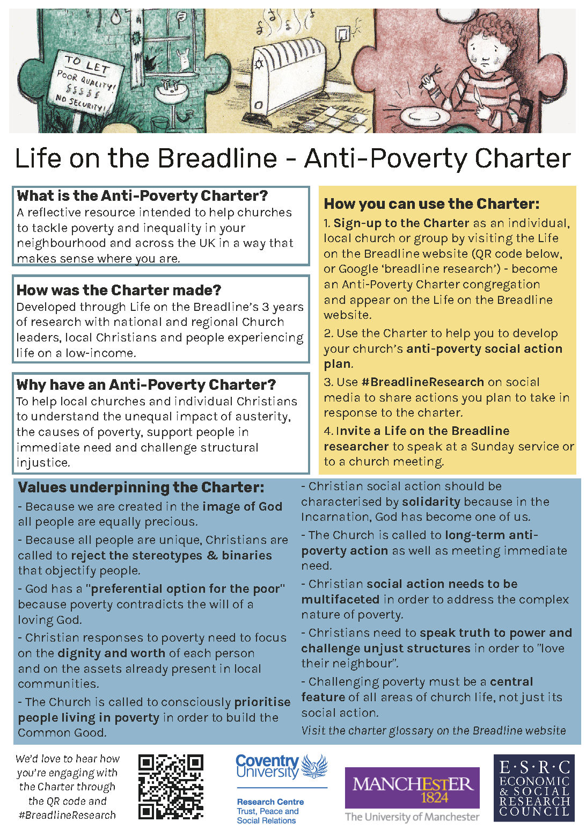
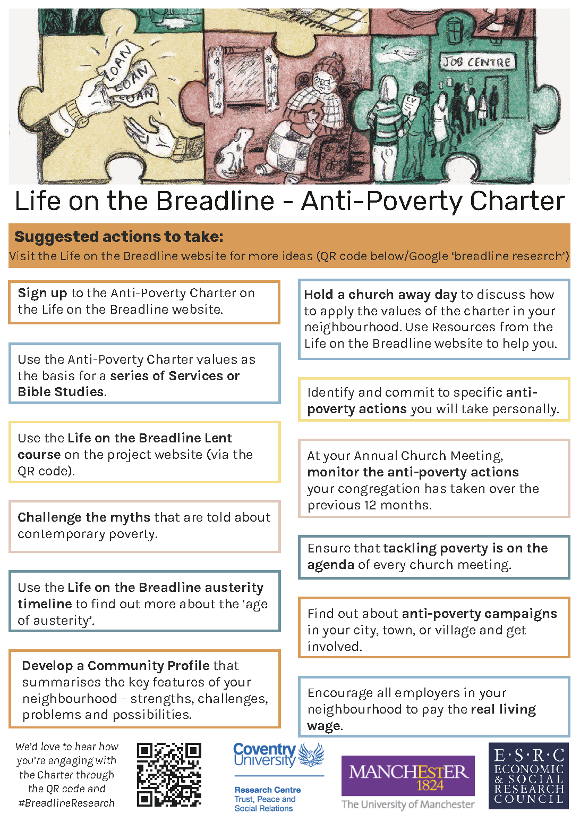
The Anti-Poverty Charter

Slide 20
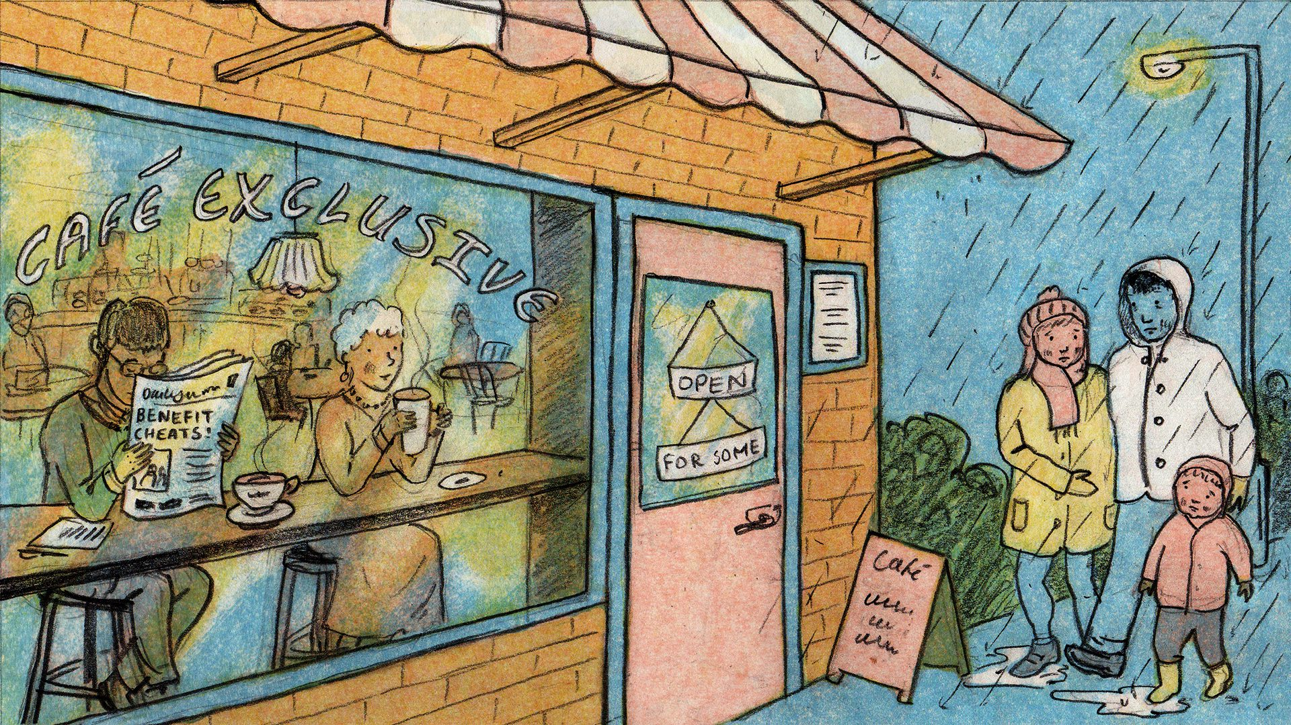
https://breadlineresearch.coventry.ac.uk/

