Slide 1


1 Peter 2:4–10
Homiletic: how might we communicate this message today?

Slide 2
finding the homiletic thread

Slide 3
where is the movement in this passage?
⁴ Come to him, a living stone, though rejected by mortals yet chosen and precious in God’s sight, and ⁵ like living stones let yourselves be built into a spiritual house, to be a holy priesthood, to offer spiritual sacrifices acceptable to God through Jesus Christ.

Slide 4
where is the movement in this passage?
⁶ For it stands in scripture: “See, I am laying in Zion a stone, a cornerstone chosen and precious, and whoever believes in him will not be put to shame.” ⁷ This honour, then, is for you who believe, but for those who do not believe, “The stone that the builders rejected has become the very head of the corner,” ⁸ and “A stone that makes them stumble and a rock that makes them fall.”

Slide 5
where is the movement in this passage?
They stumble because they disobey the word, as they were destined to do. ⁹ But you are a chosen people, a royal priesthood, a holy nation, God’s own people, in order that you may proclaim the excellence of him who called you out of darkness into his marvellous light.
¹⁰ Once you were not a people, but now you are God’s people; once you had not received mercy, but now you have received mercy.

Slide 6
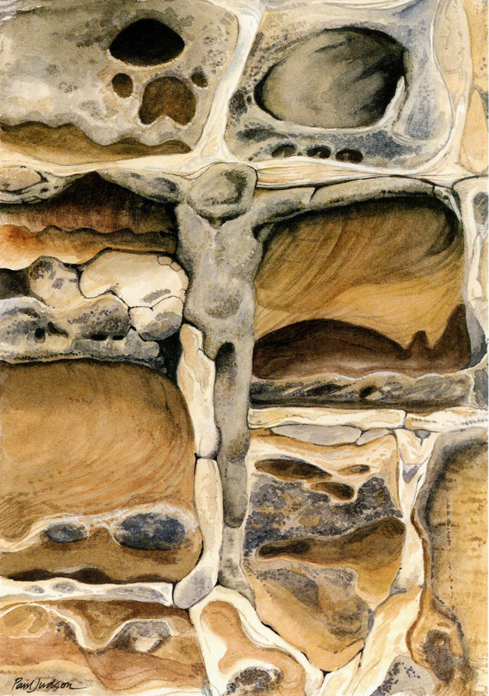
“Come to him, a living stone” (v4)
“let yourselves be built into a spiritual house/priesthood to offer sacrifices” (v5)
“in order that you may proclaim the excellence of him who called you” (v9)

Slide 7
COME: INVITATION
“Come to him, a living stone” (v4)

Slide 8
YIELD: FORMATION
“let yourselves be built ” (v5)

Slide 9
LIVE: PROCLAMATION
“proclaim the excellence of him who called you” (v9)

Slide 10
COME
YIELD
LIVE

Slide 11
Preaching moves us to be who God calls us to be: missional disciples, ambassadors of Jesus’ joyful news

