Slide 1
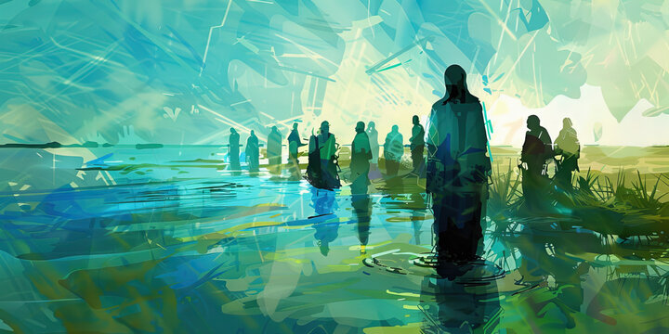

Bible study: 2 Kings 5:1-15
Rev Dr Andrew Stobart
principal@cliffcollege.ac.uk

Slide 2
Text
Layers
Threads

Slide 3
Naaman, commander of the army of the king of Aram, was a great man and in high favour with his master because by him the Lord had given victory to Aram. The man, though a mighty warrior, suffered from a skin disease.
² Now the Arameans on one of their raids had taken a young girl captive from the land of Israel, and she served Naaman’s wife. ³ She said to her mistress, “If only my lord were with the prophet who is in Samaria! He would cure him of his skin disease.” ⁴ So Naaman went in and told his lord just what the girl from the land of Israel had said. ⁵ And the king of Aram said, “Go, then, and I will send along a letter to the king of Israel.”
Text

Slide 4
He went, taking with him ten talents of silver, six thousand shekels of gold, and ten sets of garments. ⁶ He brought the letter to the king of Israel, which read, “When this letter reaches you, know that I have sent to you my servant Naaman, that you may cure him of his skin disease.”
⁷ When the king of Israel read the letter, he tore his clothes and said, “Am I God, to give death or life, that this man sends word to me to cure a man of his skin disease? Just look and see how he is trying to pick a quarrel with me.”
Text

Slide 5
⁸ But when Elisha the man of God heard that the king of Israel had torn his clothes, he sent a message to the king, “Why have you torn your clothes? Let him come to me, that he may learn that there is a prophet in Israel.”
⁹ So Naaman came with his horses and chariots and halted at the entrance of Elisha’s house. ¹⁰ Elisha sent a messenger to him, saying, “Go, wash in the Jordan seven times, and your flesh shall be restored, and you shall be clean.” ¹¹ But Naaman became angry and went away, saying, “I thought that for me he would surely come out and stand and call on the name of the Lord his God and would wave his hand over the spot and cure the skin disease!”
Text

Slide 6
¹² “Are not Abana and Pharpar, the rivers of Damascus, better than all the waters of Israel? Could I not wash in them and be clean?” He turned and went away in a rage. ¹³ But his servants approached and said to him, “Father, if the prophet had commanded you to do something difficult, would you not have done it? How much more, when all he said to you was, ‘Wash, and be clean’?” ¹⁴ So he went down and immersed himself seven times in the Jordan, according to the word of the man of God; his flesh was restored like the flesh of a young boy, and he was clean.
Text

Slide 7
¹⁵ Then he returned to the man of God, he and all his company; he came and stood before him and said, “Now I know that there is no God in all the earth except in Israel.”
2 Kings 5:1–15a (NRSVUE)
Text

Slide 8
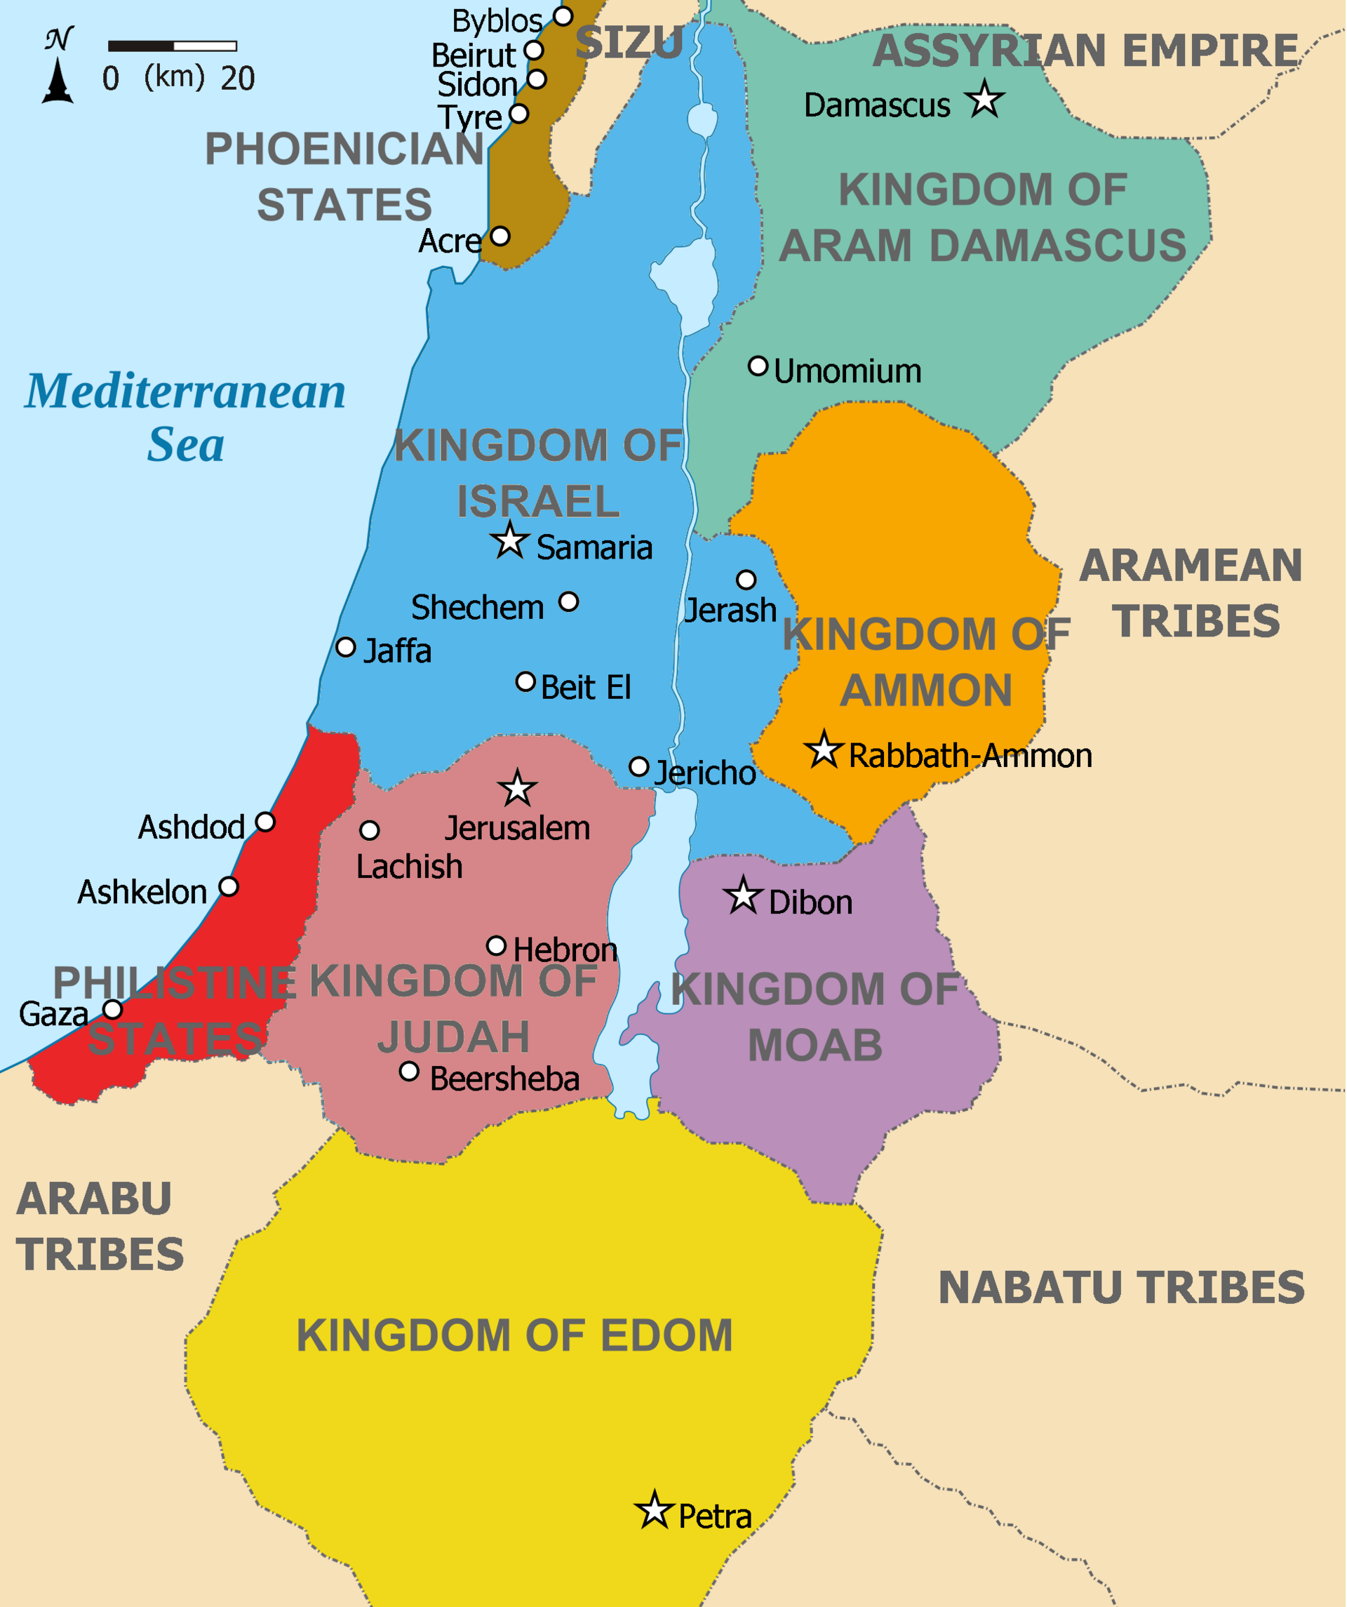
9th Century BCE (c850)
Israel; Samaria; Jehoram
Elisha; ‘man of God’
Aram; Damascus; Ben Hadad II
Naaman; ‘great man’, ‘great things’
‘Pleasant’/skin disease
Trafficked servant girl
Naaman’s wife and servants
Elisha’s servant, Gehazi

Slide 9
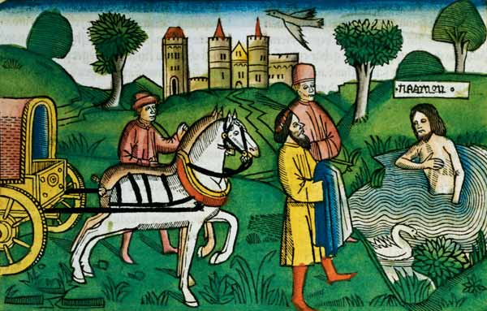
Compassion: an observant servant girl
Comedy: misunderstandings
Cajoling: power/status
^{15th C, German}

Slide 10
A story of surprising healing
Layers

Slide 11
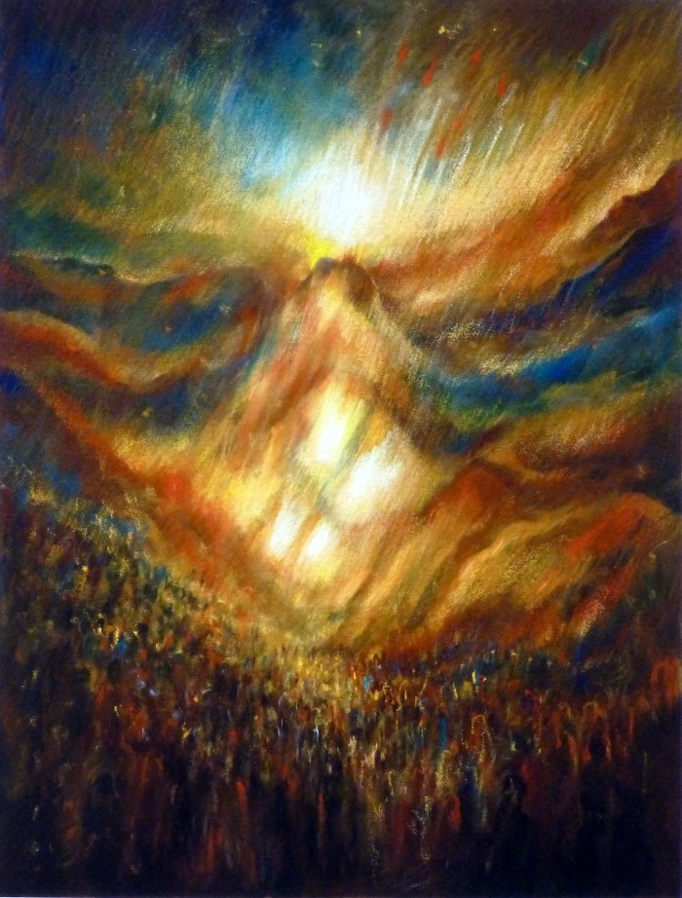
Deuteronomic history (Joshua–2 Kings)
‘second law’/restatement
Covenantal faithfulness/unfaithfulness
Shunammite woman (chs 4 & 8; restoration of son, restoration of home)
Famine/siege of Samaria (ch 6): who is really sick?
Obedience as ‘conversion’

Slide 12
A story of surprising healing
A story of surprising obedience
Layers

Slide 13
Luke 4:27, ‘There were many with a skin disease in Israel in the time of the prophet Elisha, and none of them was cleansed except Naaman the Syrian.’
Baptism in the Jordan; Luke 3:3, ‘baptism of repentance for the forgiveness of sins’; Isaiah, ‘all flesh shall see the salvation of God.’
Baptism, renewal and confession: ‘Now I know…’

Slide 14
A story of surprising healing
A story of surprising obedience
A story of surprising salvation
Layers

Slide 15
Testimony: use your words
unique testimony: (not rp’ but sp’)
mediated testimony (standing before/with/near)
testimony begets testimony
God’s people as those who ‘bear testimony’, as the human side of the covenantal relationship

Slide 16
Identity: God ‘makes alive’!
v7: ‘Am I God, to give death or life?’ (mt hy)
Deut 32:39: ‘See now that I, even I, am he, and there is no god beside me; I kill and I make alive.’
This is a condition and a consequence of the covenantal relationship.
Ezekiel 37: the ‘effective culmination’ of the whole OT
18 Benedictions: ‘You are mighty forever, my Lord. You are the one who revives the dead, powerful to save.’
God’s people are ‘made alive’ by God’s faithfulness

Slide 17
Mission: transgressing, transforming and removing ‘boundaries’
Role and power reversals: gender, status, colonial mindsets
Radical mission (especially care) upsets the carefully constructed boundaries of society, and as such is a practice that can awaken people to the joyful news of God’s kingdom.

Slide 18
Testimony: use your words
Identity: the God who makes alive!
Mission: transgressing, transforming and removing ‘boundaries’
Threads

Slide 19
How can our own boundary-crossing testimonies introduce others to our living and life-giving God?

